Slide 1
Reducing Project Duration Ch. 9, T1
M K Hamirwasia
WILPD

Slide 2
AE/DE/MM/ES/POM ZG523-Merged
Project Management
Lecture No. 17

Slide 3
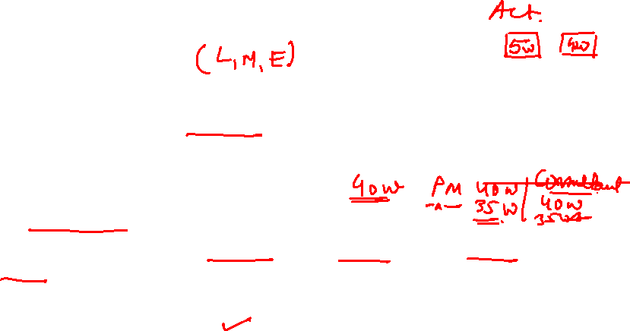
Project Cost-Duration Graph
Project Direct Costs
Labour, materials, equipment, and sometimes subcontractors.
Direct costs are assigned directly to a work package or an activity.
Inverse relationship with duration.
Project Indirect Costs
Overhead costs such as supervision, administration, consultants, and interest.
Indirect costs can not be associated with any work package or activity, and hence the term.
Direct relationship with duration.
Indirect costs vary directly with time. Any reduction in duration should result in a reduction of indirect costs.

Slide 4
PROJECT COST-DURATION GRAPH
Indirect costs continue for the lifetime of the project.
Direct costs increase as the project duration is reduced from its original planned duration.
Identify those activities that will have the greatest impact on reducing project time at least cost.
Critical activities are searched to find the lowest direct-cost activities that will reduce the project duration.

Slide 5
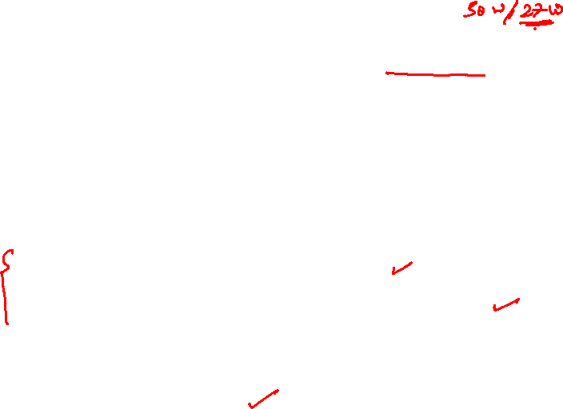
Project Cost-Duration Graph
When project durations are imposed, direct costs no longer represent low-cost, efficient methods.
Any reduction in activity time adds to the cost of the activity.
When you shorten the duration,
Indirect costs – there are savings
Direct costs – there is increase in the cost
Ideally
Incremental Indirect cost savings > incremental direct cost expenditure

Slide 6
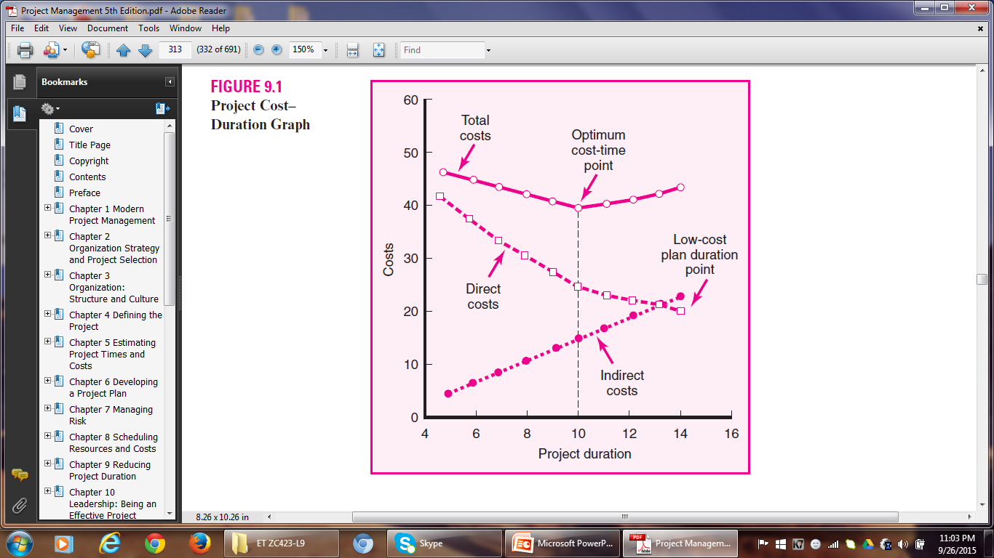
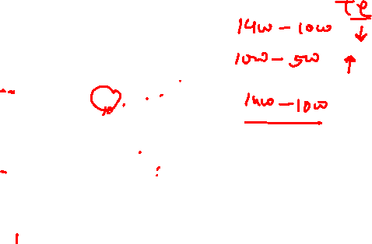
Project Cost-Duration Graph

Slide 7
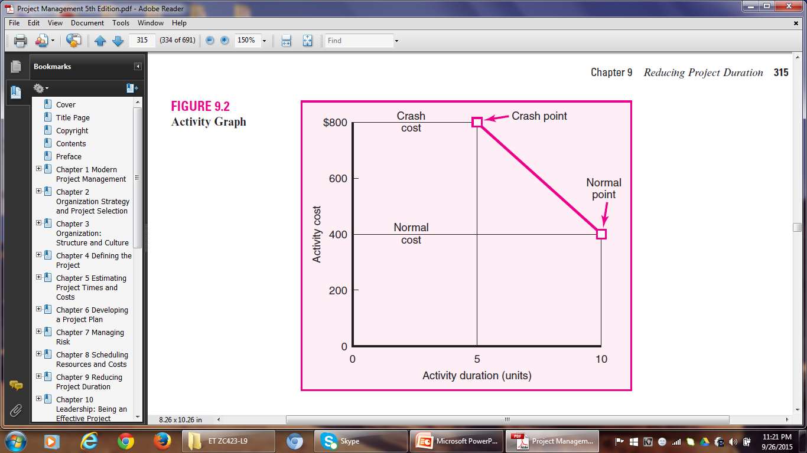
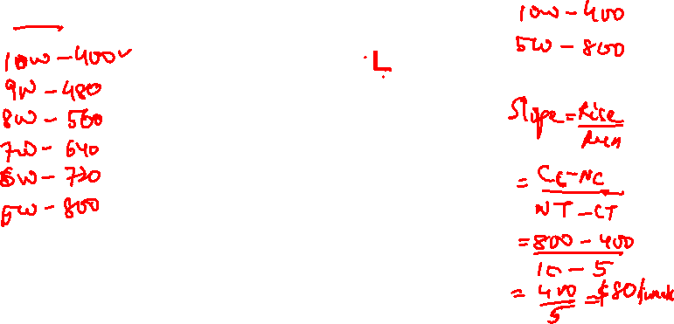
CONSTRUCTING A PROJECT COST-DURATION GRAPH

Slide 8
Constructing a Project Cost-Duration Graph
Useful Terms
Normal time for an activity represents low-cost, realistic, efficient ways for completing the activity under normal conditions.
Crashing is reducing the duration of an activity to accelerate its completion.
Crash time is the shortest possible time in which an activity can realistically be completed.
Crash cost is the direct cost of completing an activity in its crash time.
Crash Cost > Normal Cost Crash Time < Normal Time

Slide 9
Constructing Cost-Duration Graph
Identify critical activities that can be shortened with the smallest increase in cost per unit time.
The slope of the line connecting the normal point and the crash point represents the cost of reducing the time of the activity per unit of time.
A steeper slope means that it will cost more to shorten one time unit.
The activities with the least slope will cost the least to reduce the duration one unit time.
Having calculated the slope of activities, the project manager can arrive at a decision as to which activities to shorten.

Slide 10
Constructing a Cost-Duration Graph
Cost slope = Rise (on the y axis)
Run (on the x axis)
= Crash Cost – Normal Cost
Normal Time – Crash Time
= CC – NC
NT – CT
= $800 - $400
10 – 5
= $80 per unit of time

Slide 11
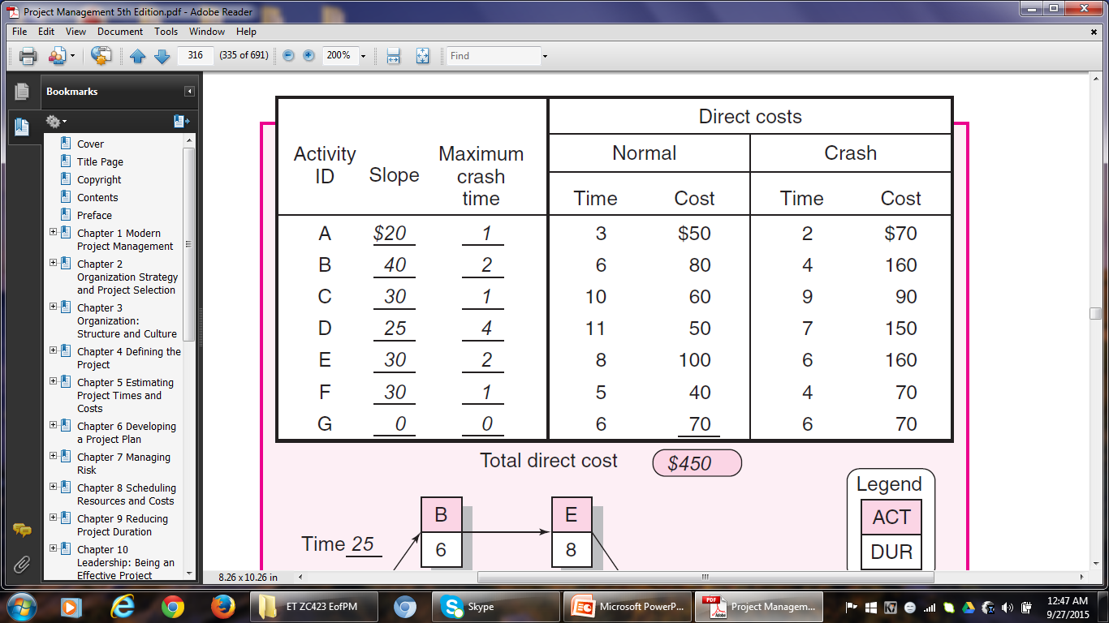

EXAMPLE

Slide 12
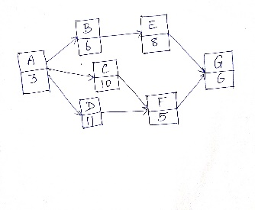
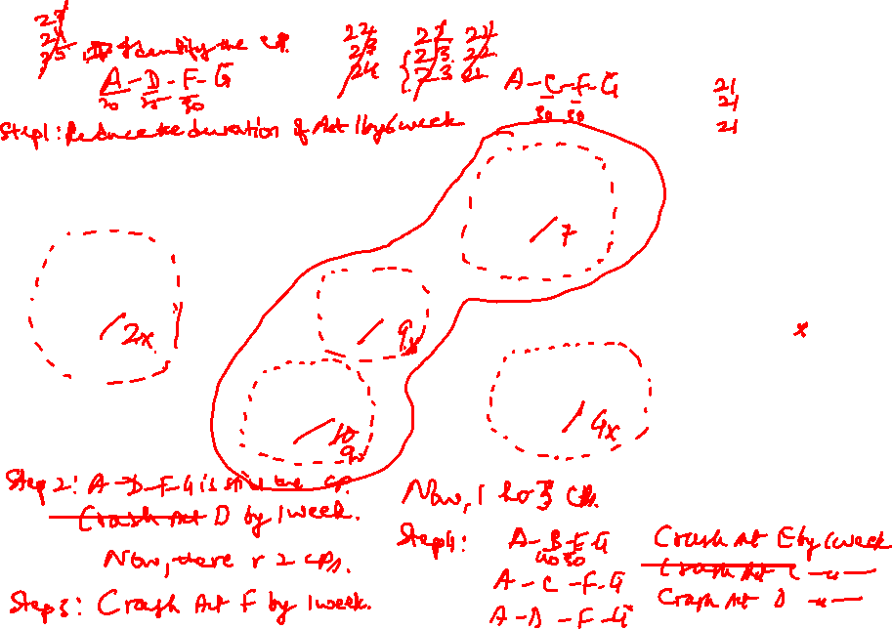

Slide 13
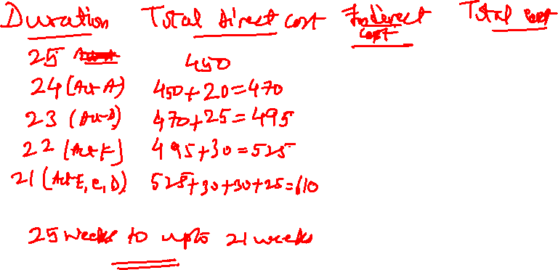

Slide 14
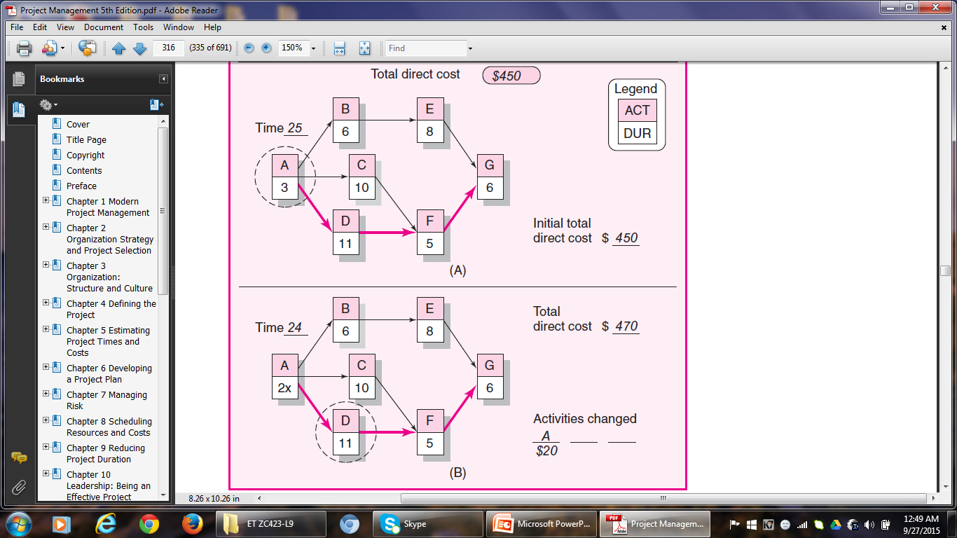

Slide 15
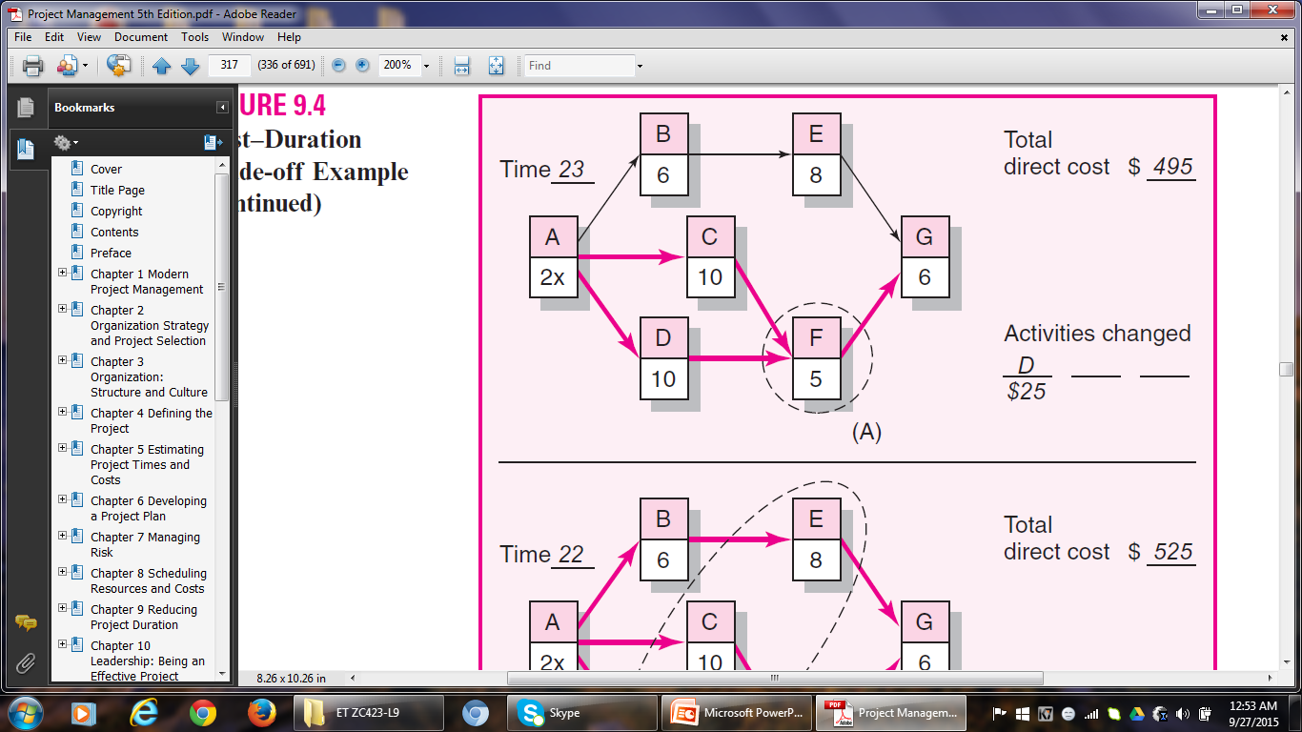

Slide 16
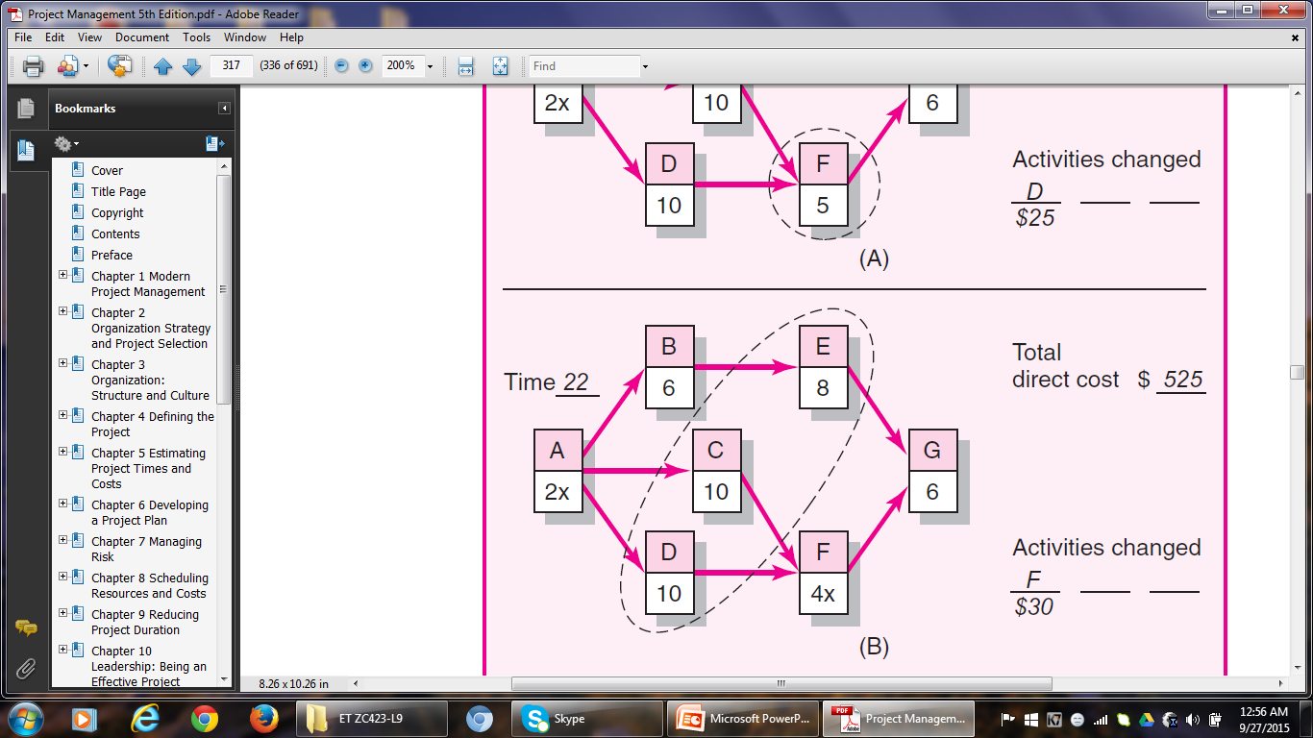

Slide 17
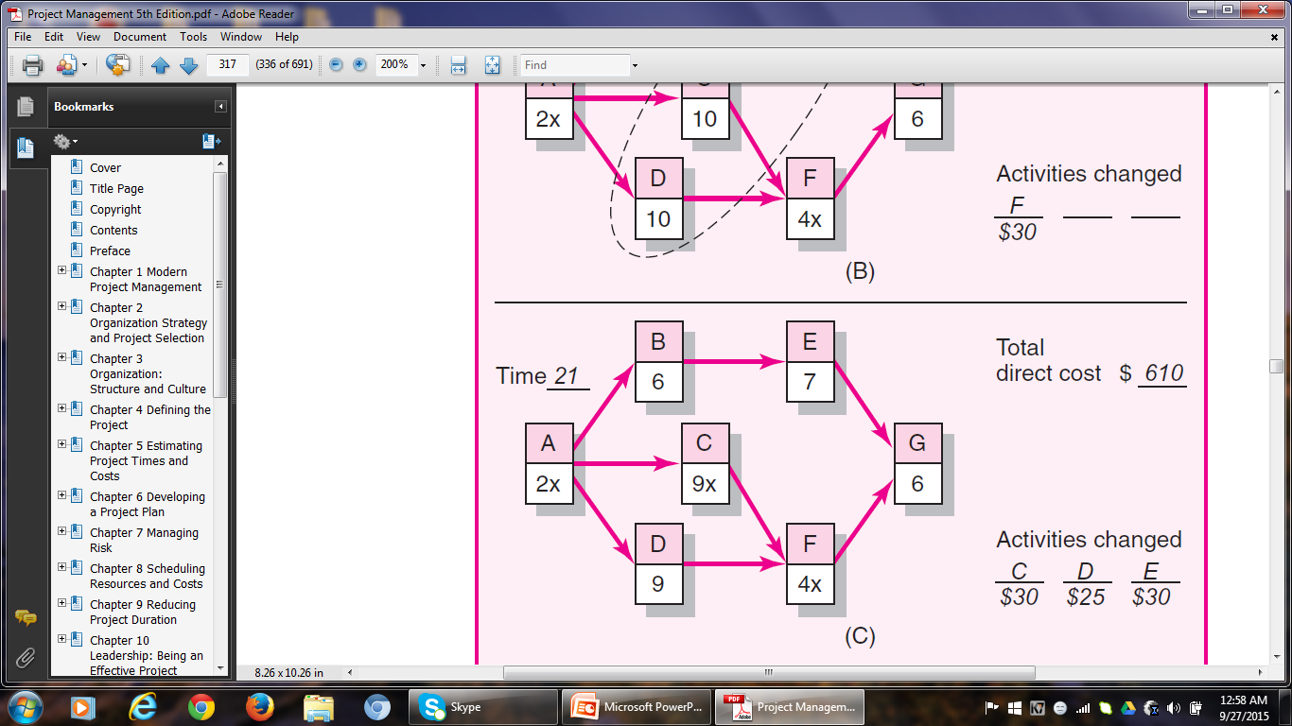

Slide 18
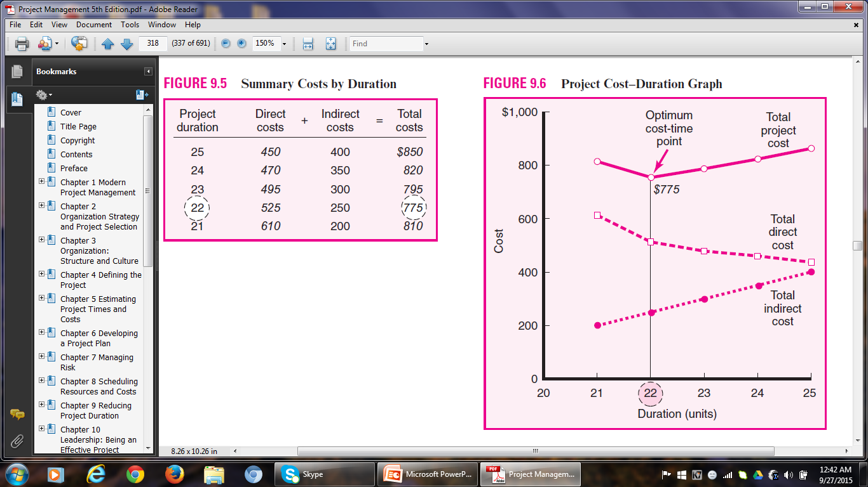
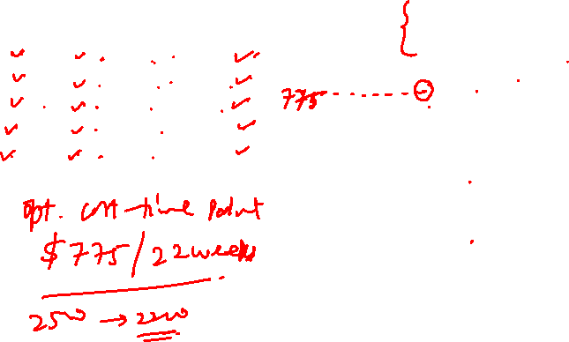

Slide 19

Reducing Project Cost
Some Reasons:
The profit margin in the case of fixed-bid projects is very tight. Hence there is a dire need to reduce cost.
Contractors purposely lower bids to secure contracts.
Sometimes there are financial incentives for cost containment.
Just as reducing project duration comes at the expense of overtime, adding additional staff, and using more expensive equipment and/or materials, cost savings can be generated by increasing the duration of a project.
A smaller workforce, less-skilled labour, and cheaper equipment and materials can be used to save cost.

Slide 20
Reducing Project Cost
Options for Reducing Project Cost
Reduce Project Scope
Eg. It is a common practice to replace location shots with stock footage on over-budget movie projects.
Ask the Customer to Own more Responsibility
Eg. Homeowners use this method to save money on home improvement projects. However, the owner should have the capability to do the tasks.
Advantage – the original scope is not altered.

Slide 21
Reducing Project Cost
iii) Outsource
Experienced subcontractors often enjoy discounts on bulk material and equipment.
They may have lower overhead and labour costs.
Eg. US Companies outsource software programming jobs to Indian firms, because of the difference in salaries of software engineers.
Discuss with Project Team Members
In the light of individual expertise and experience, team members might suggest novel ways of completing the tasks at lower costs.

Slide 22
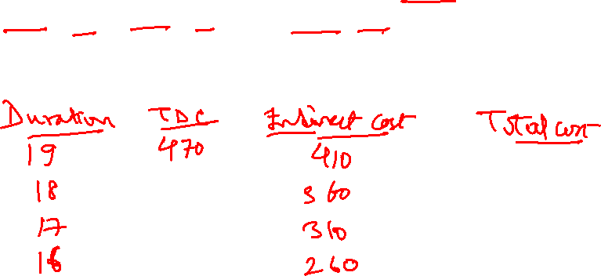
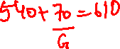
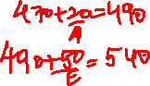
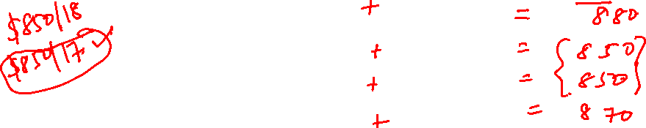
Exercise
Q. 3. Assume the network and data that follow. Compute the total direct cost for each project duration. If the indirect costs for each project duration are $410 (19 time units), $360 (18), $310 (17), and $260 (16), compute the total project cost for each duration. What is the optimum cost-time schedule for the project? What is this cost?

Slide 23
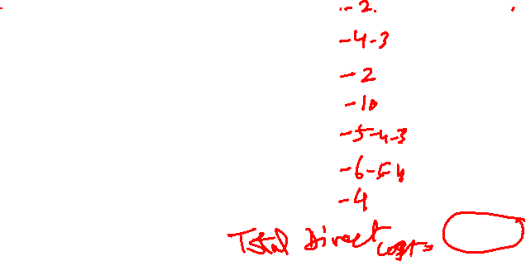
Exercise
Act. Crash Cost Max Crash Time Normal Time Normal Cost
(Slope)
A 20 1 3 50
B 60 2 5 60
C 40 1 3 70
D 0 0 10 50
E 50 3 6 100
F 100 3 7 90
G 70 1 5 50
$470

Slide 24
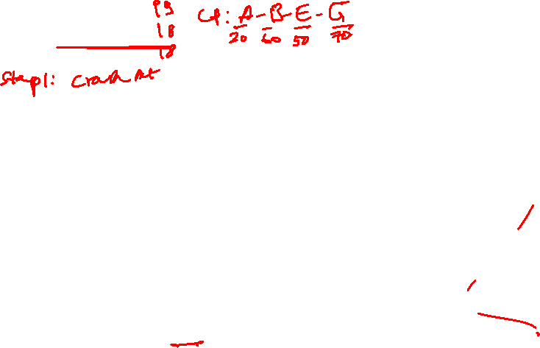
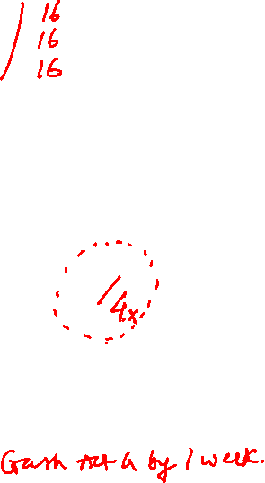
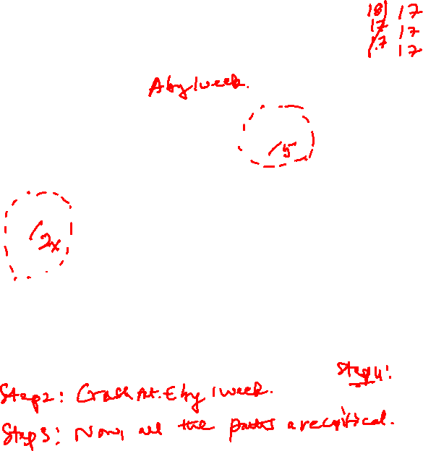
Exercise
Initial Project Duration 19
Total Direct Cost $470
B
5
E
6
A
3
C
3
F
7
G
5
D
10x

Slide 25
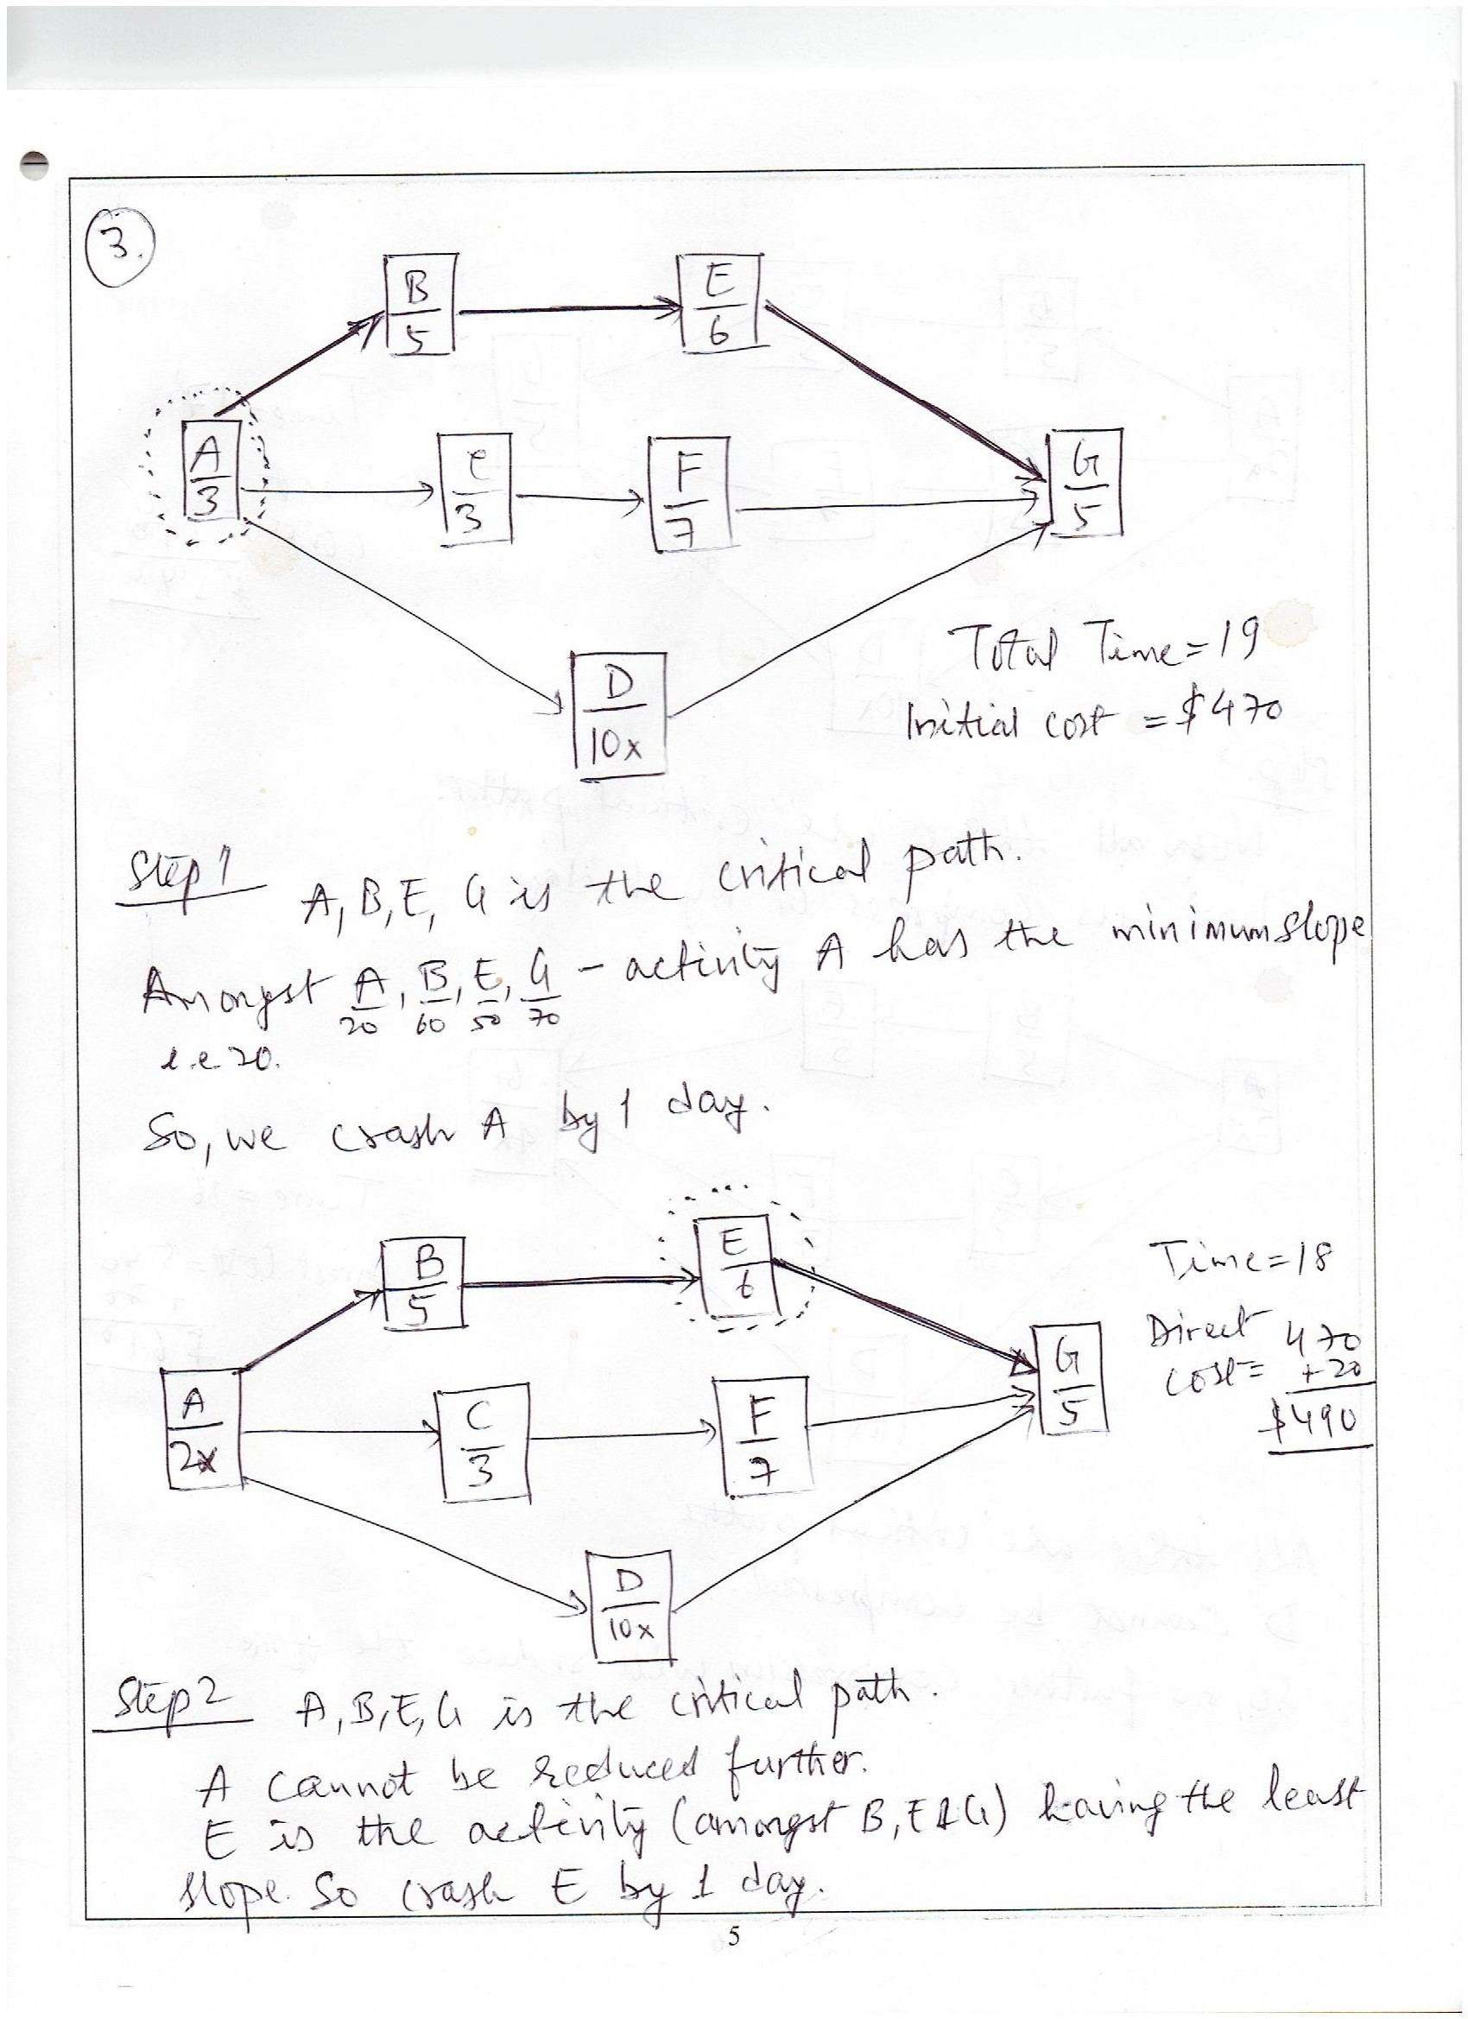
Exercise

Slide 26
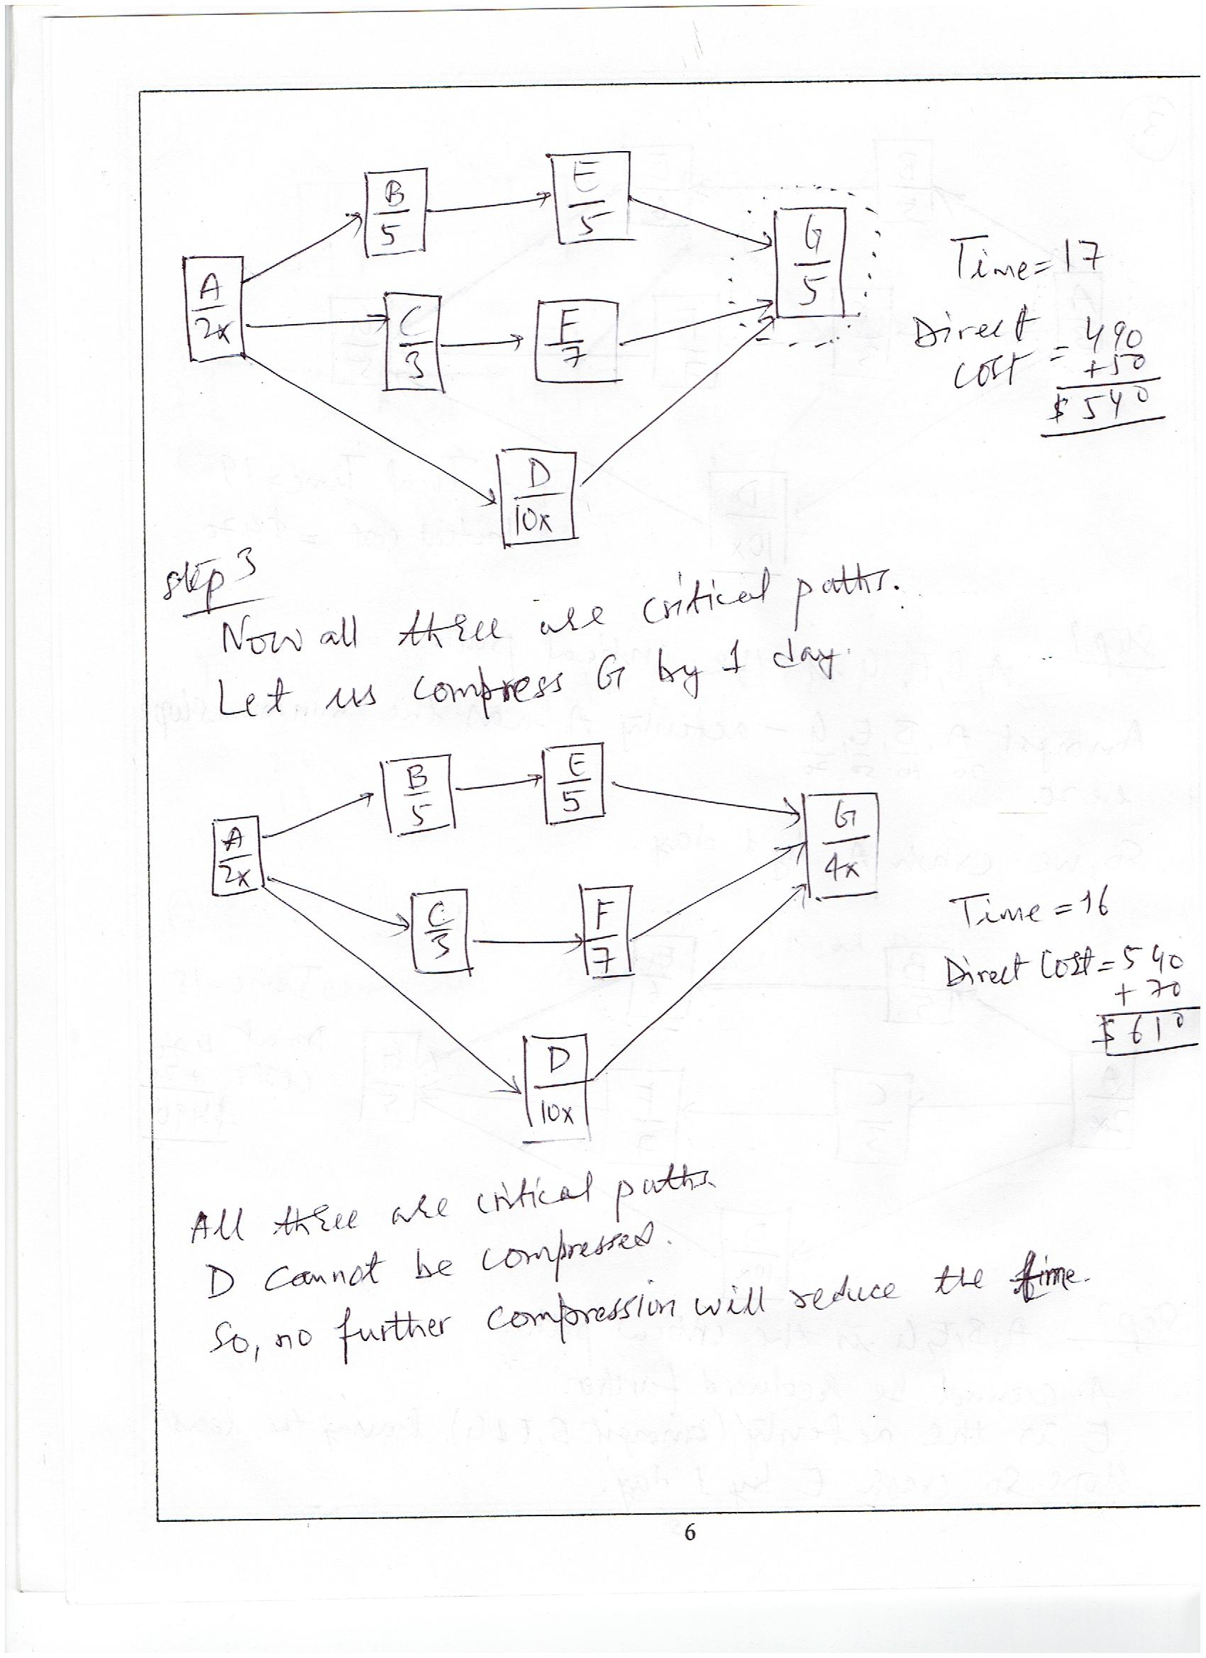
Exercise

Slide 27
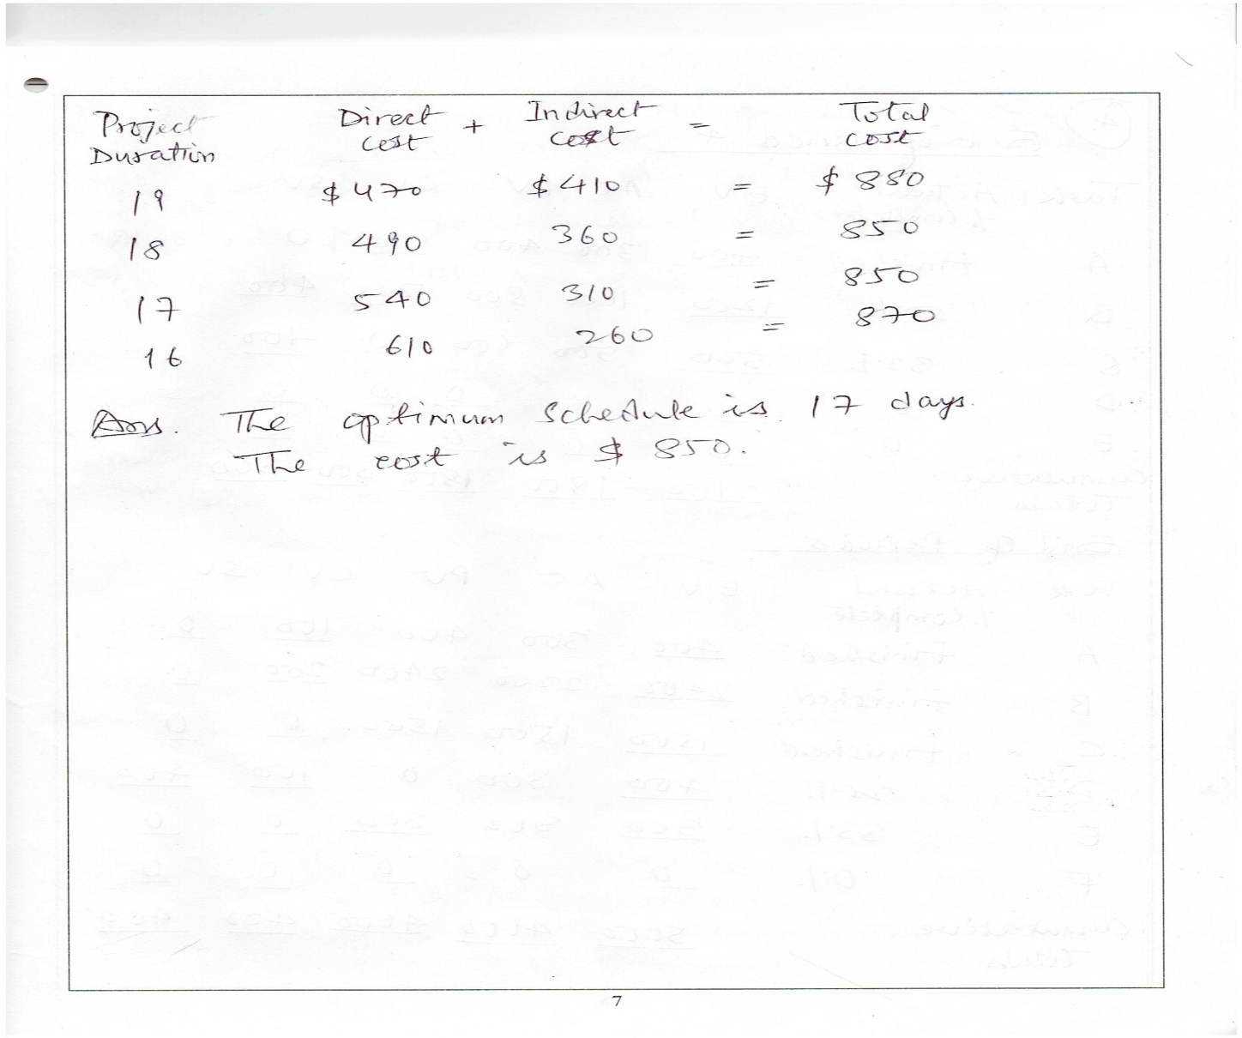
Exercise

Slide 28
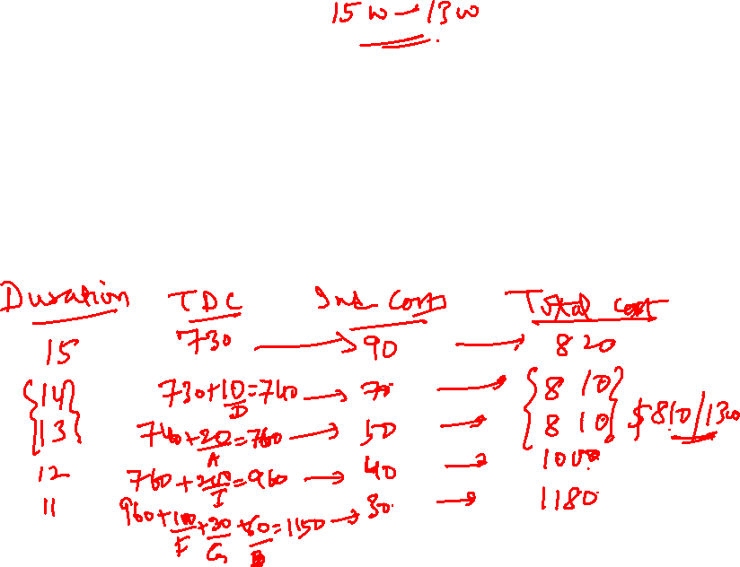

Exercise (496 - 4)
4. Given the data and information that follow, compute the total direct cost for each project duration. If the indirect costs for each project duration are $90 (15 time units), $70 (14), $50 (13), $40 (12), and $30 (11), compute the total project cost for each duration. What is the optimum cost-time schedule for the project? What is this cost?

Slide 29
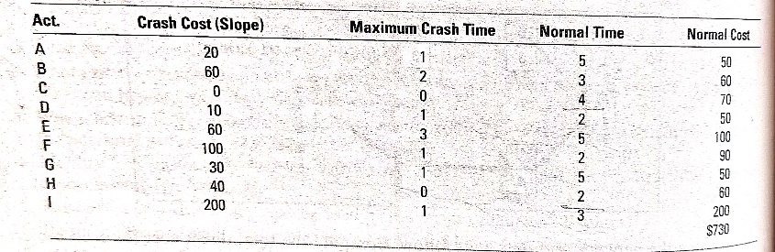
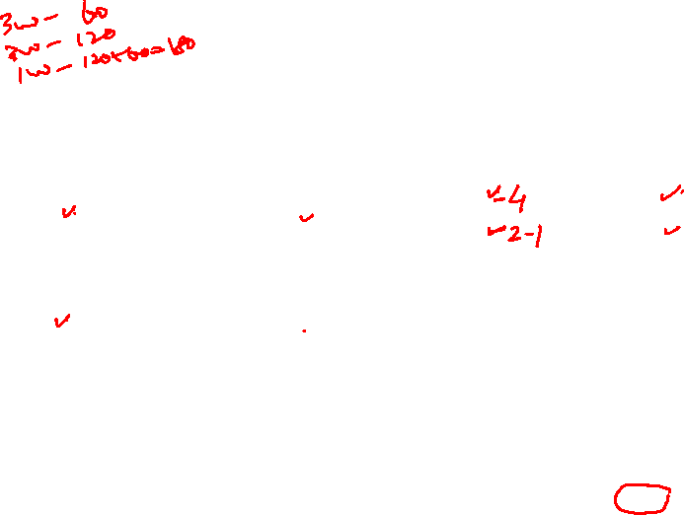

Slide 30
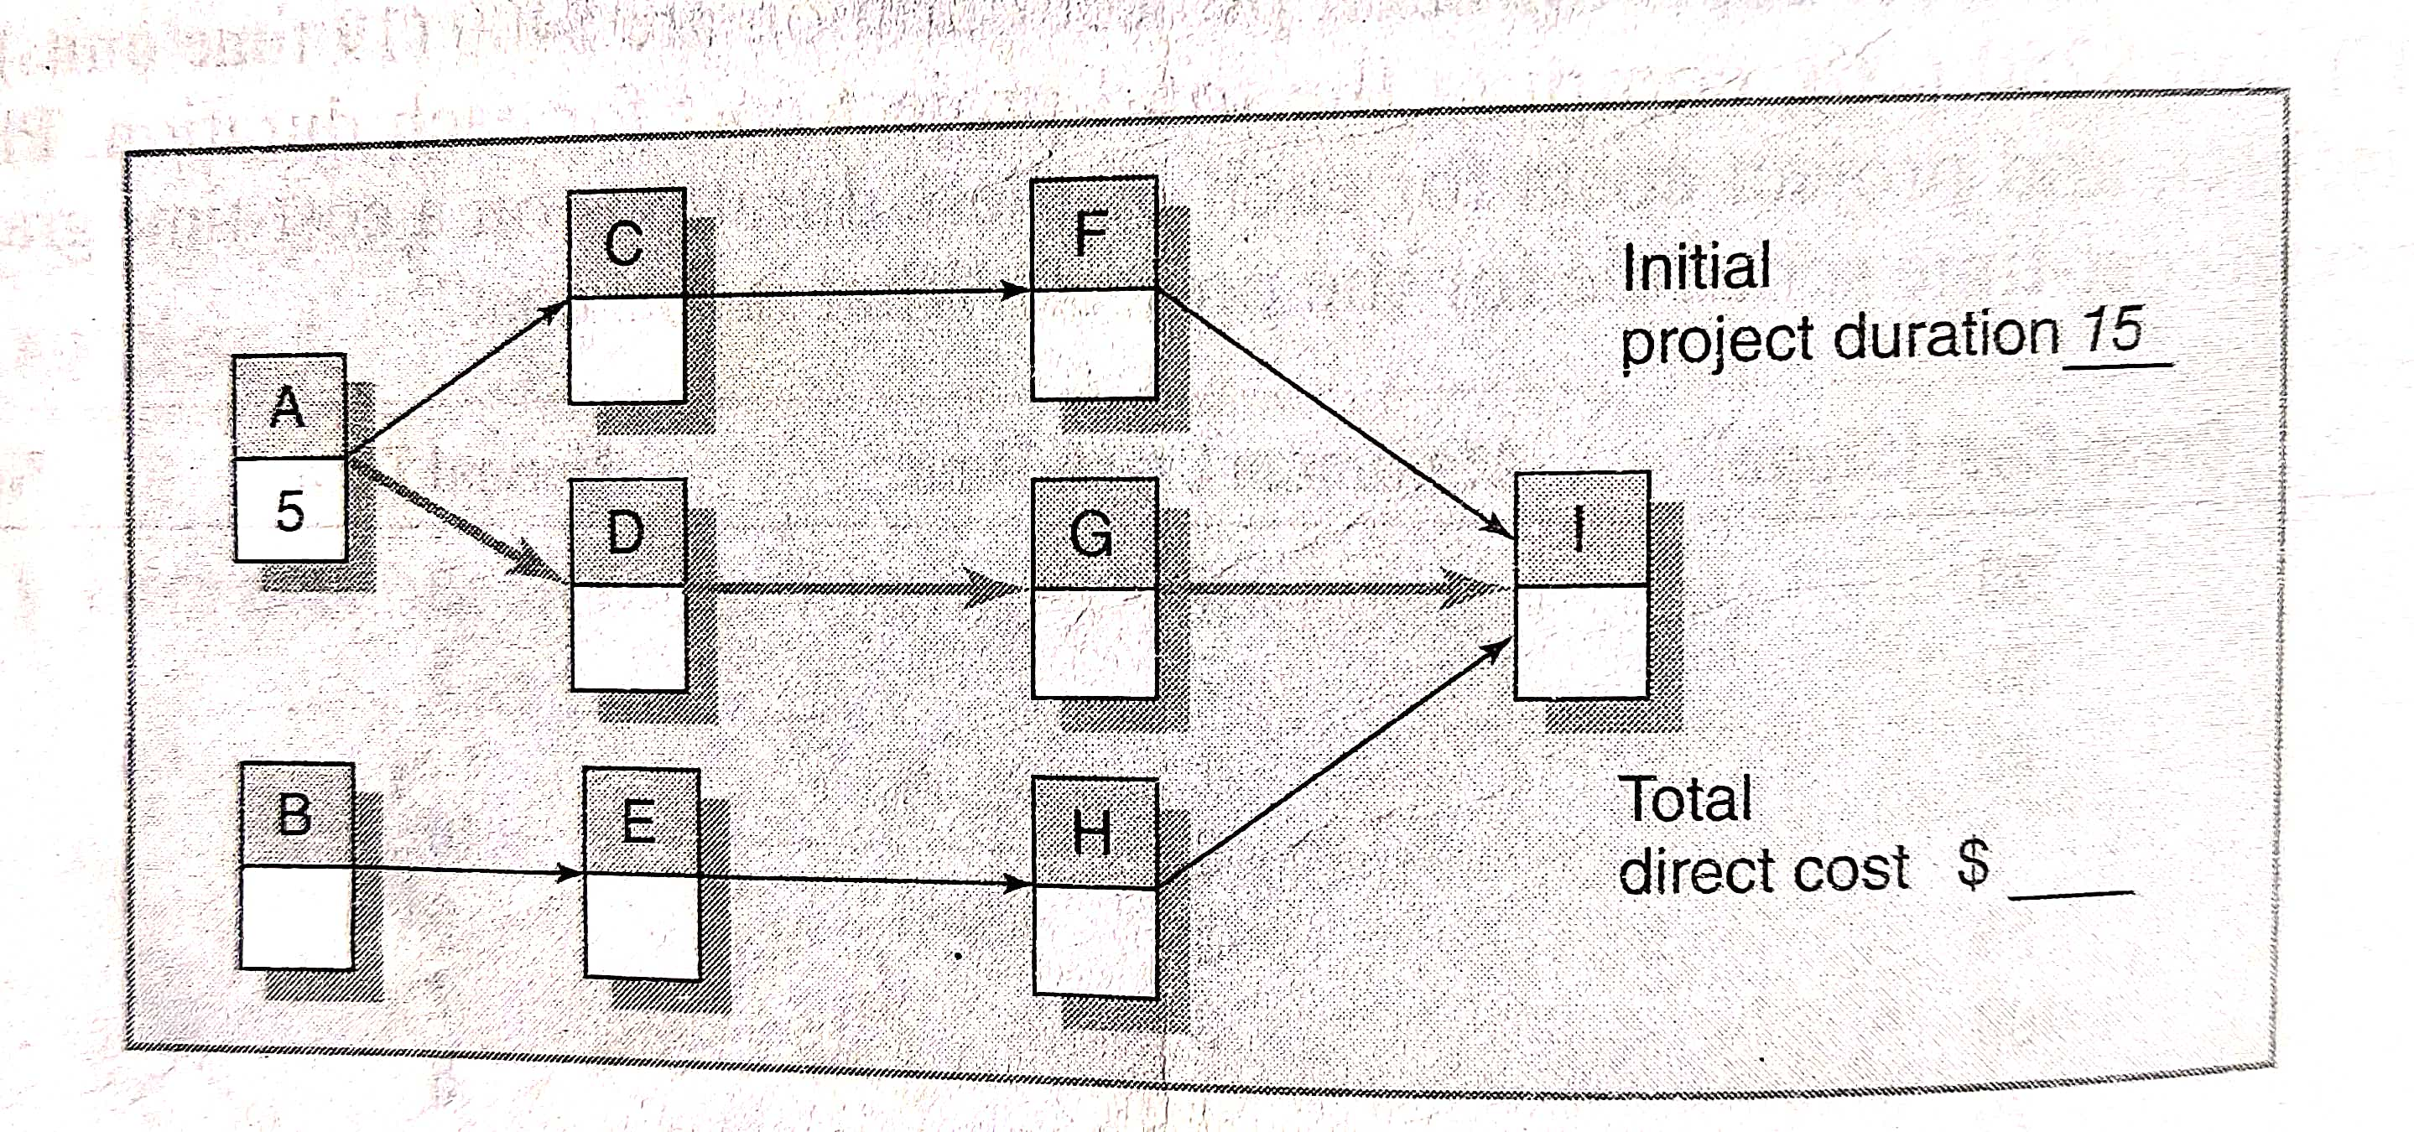
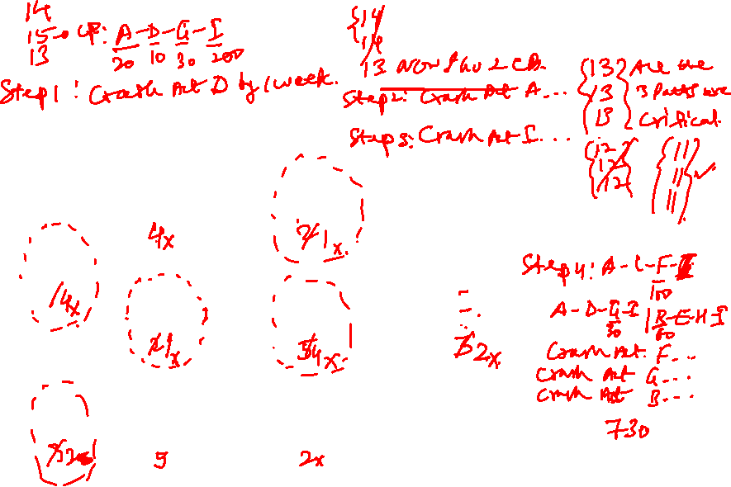

Slide 31
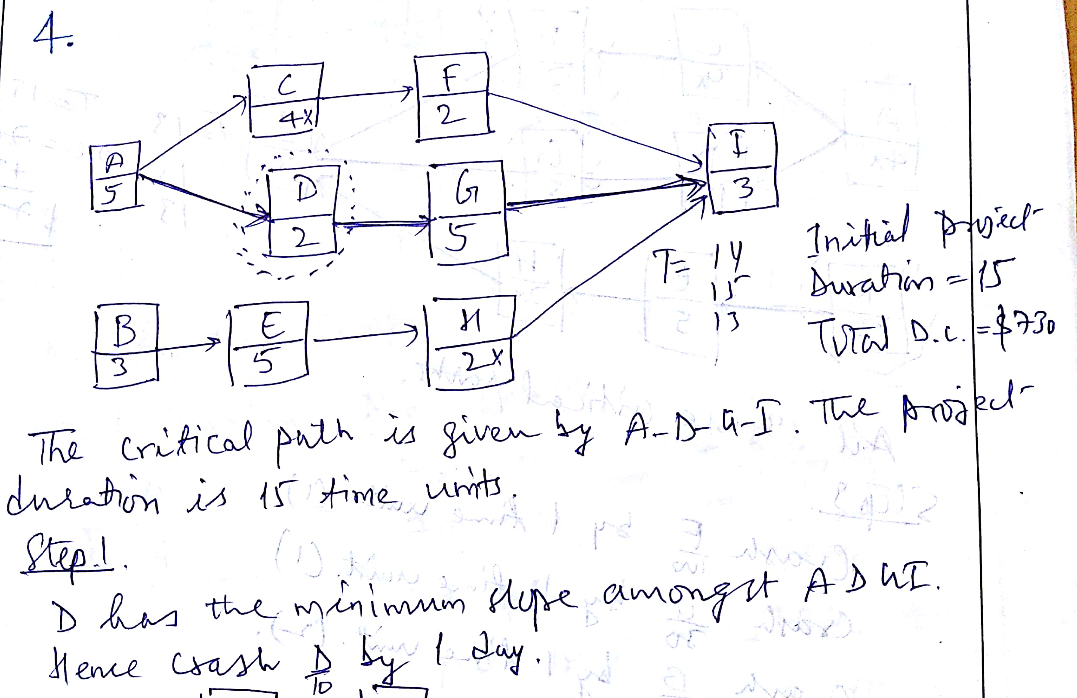
RPD

Slide 32
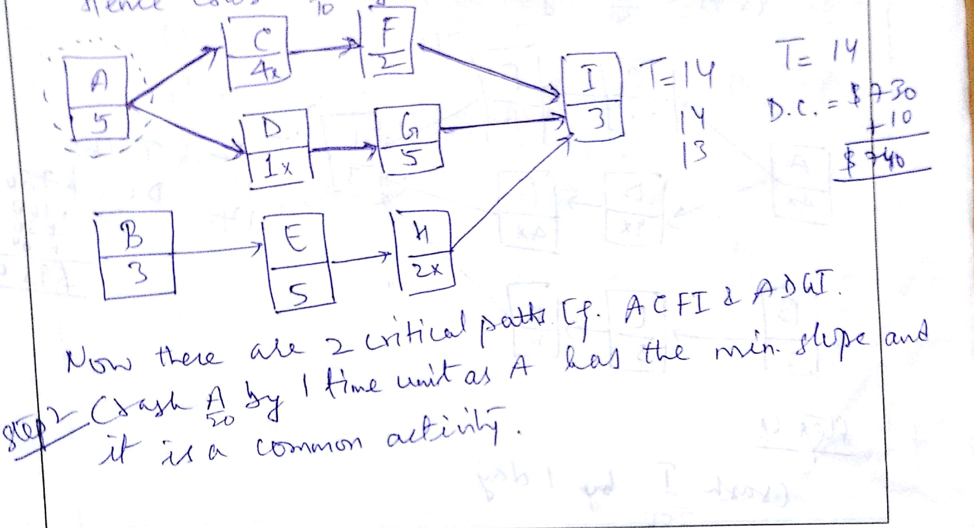
RPD

Slide 33
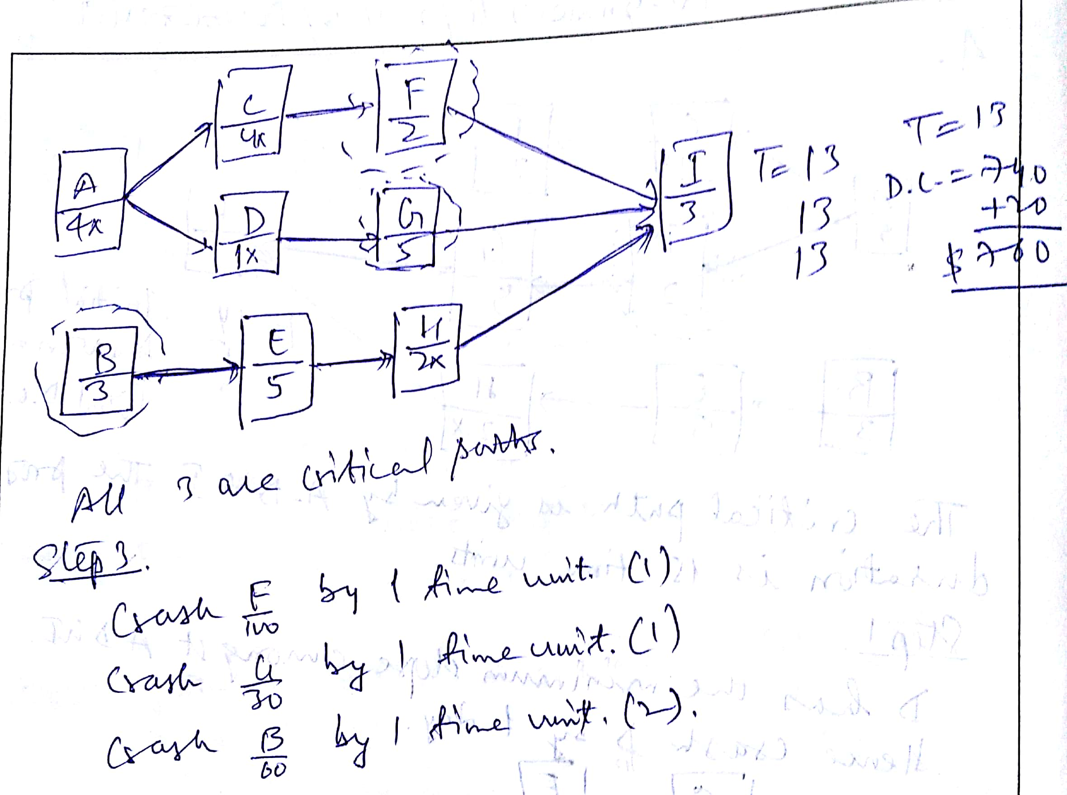
RPD

Slide 34
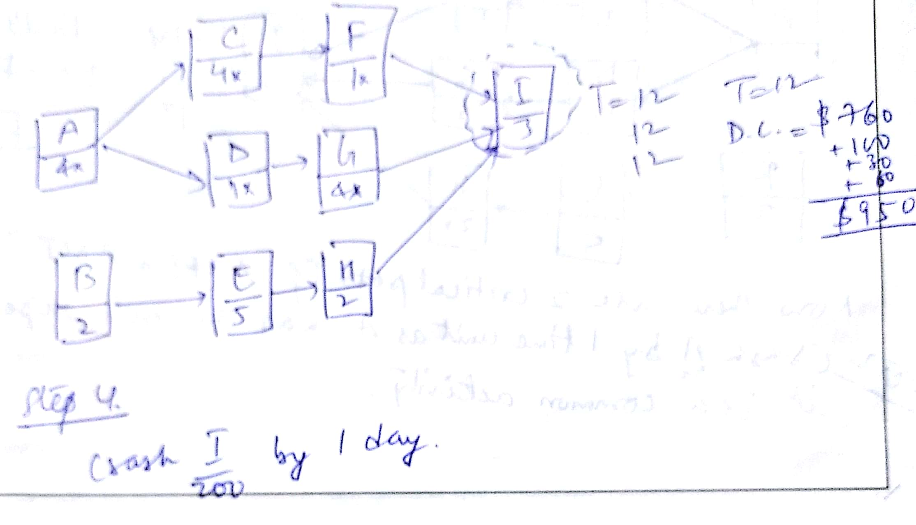
RPD

Slide 35
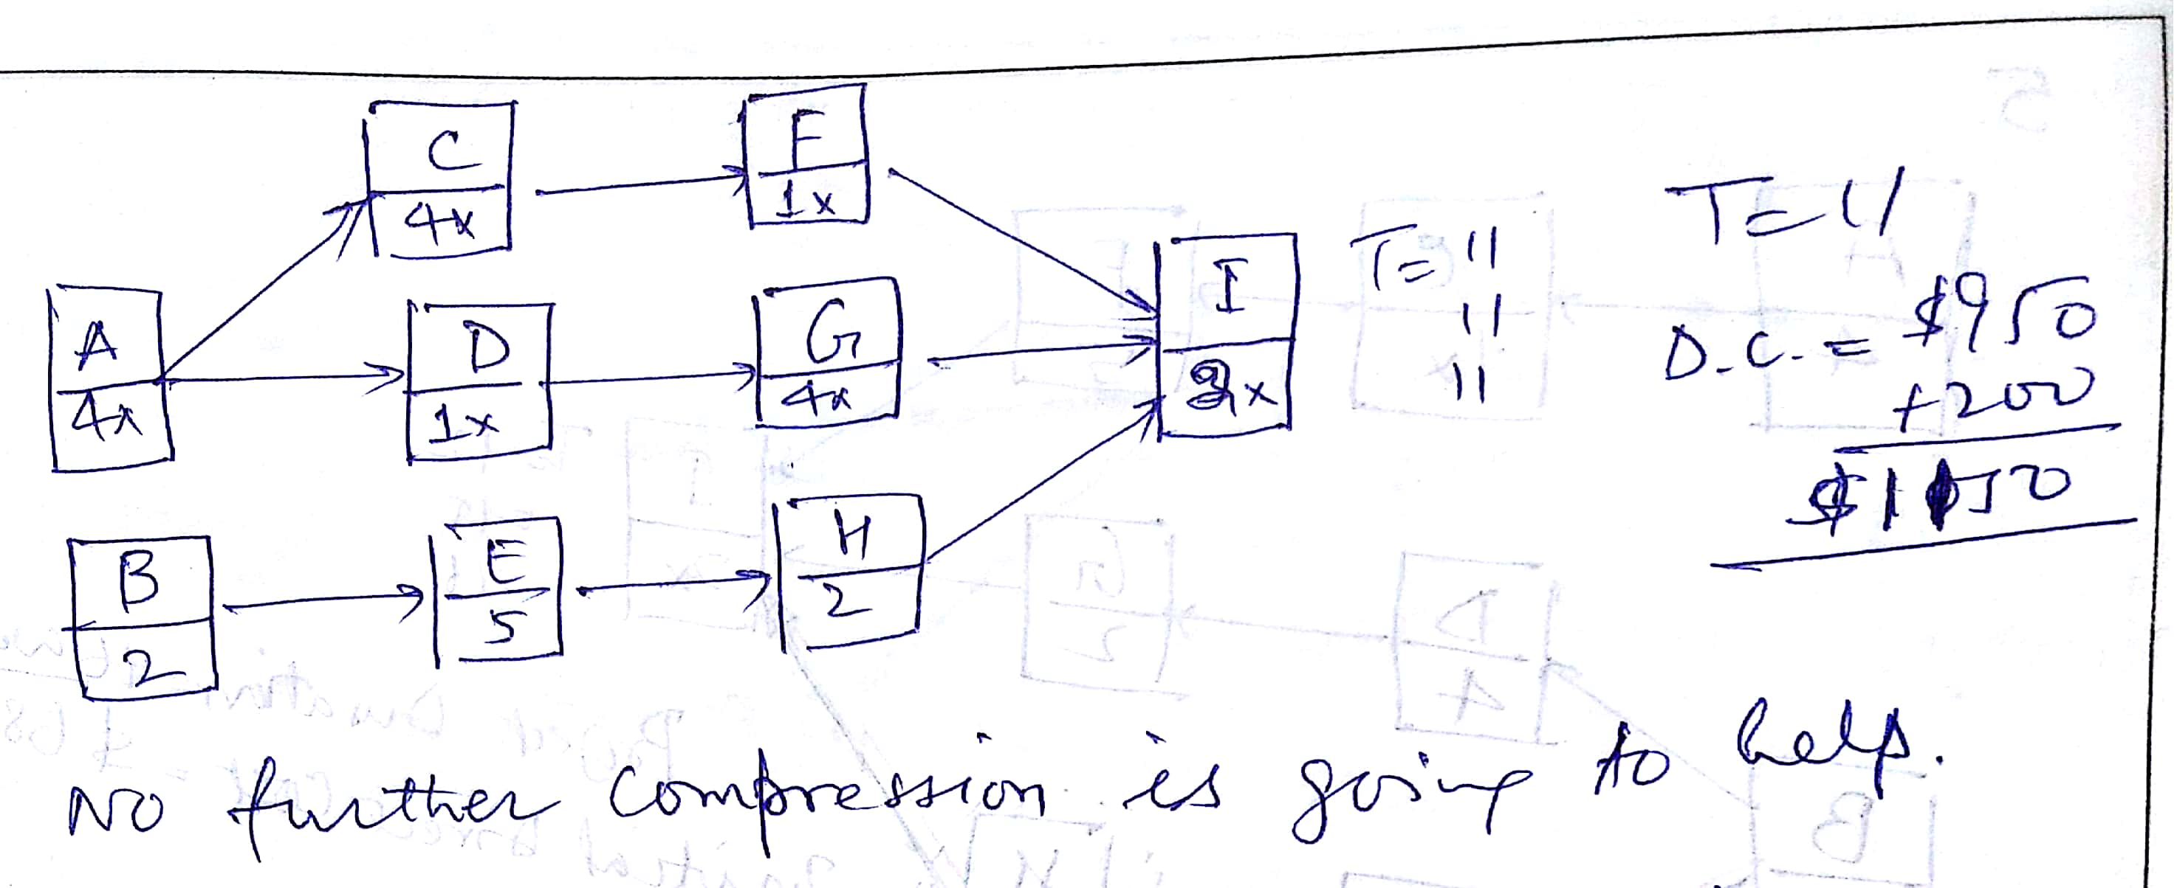
RPD

Slide 36
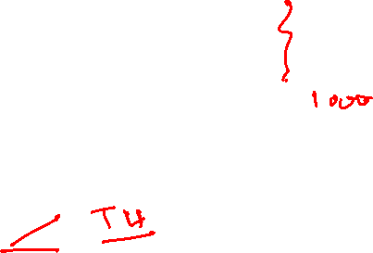
Exercise (Page 496- 4)
4. Answer
Duration Direct Cost Indirect Cost Total Cost
730 90 820
740 70 810
13* 760 50 810
12 950 40 990
1150 30 1180
Optimum Cost-Time: $ 810 / 13 Days

Slide 37

Exercise (496-497 - 5)
5. If the indirect costs for each duration are $1,200 for 16 weeks, $1,130 for 15 weeks, $1,000 for 14 weeks, $900 for 13 weeks, $860 for 12 weeks, $820 for 11 weeks, and $790 for 10 weeks, compute the total costs for each duration. Plot these costs on a graph. What is the optimum cost-time schedule?

Slide 38
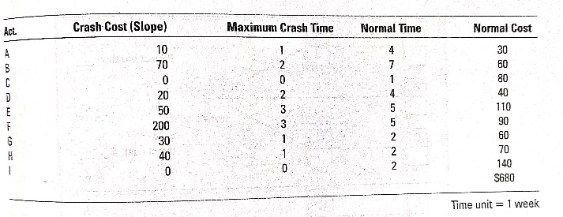


Slide 39
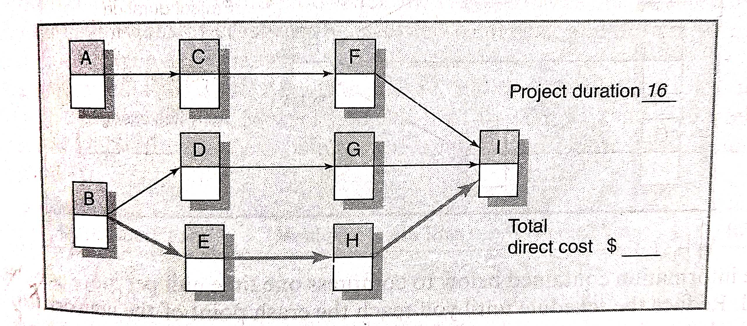
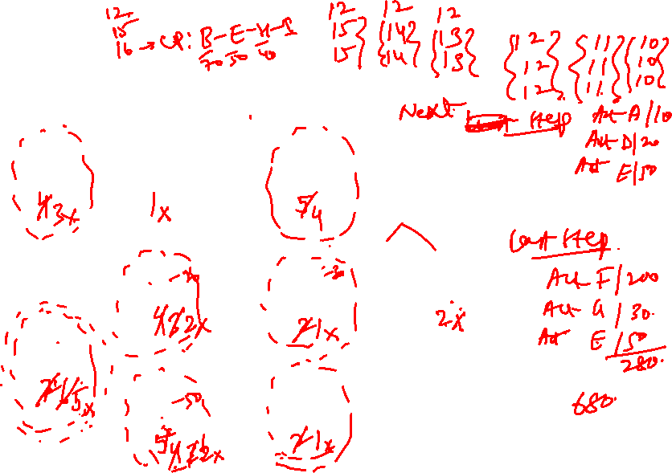

Slide 40
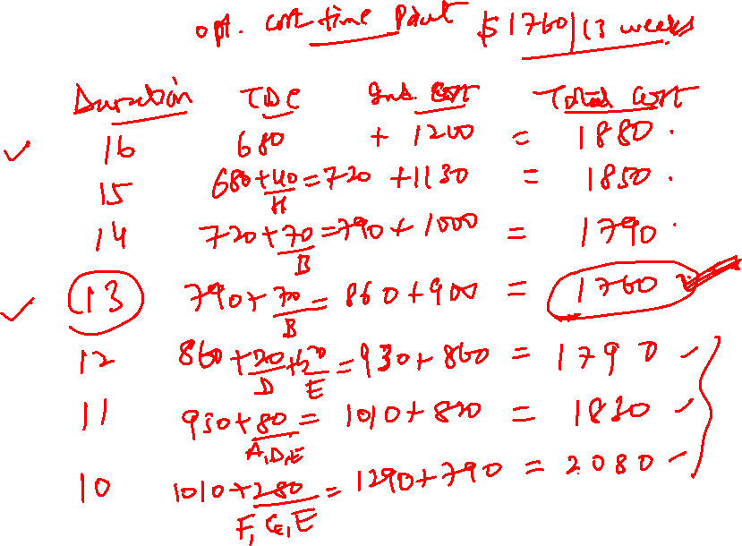

Slide 41
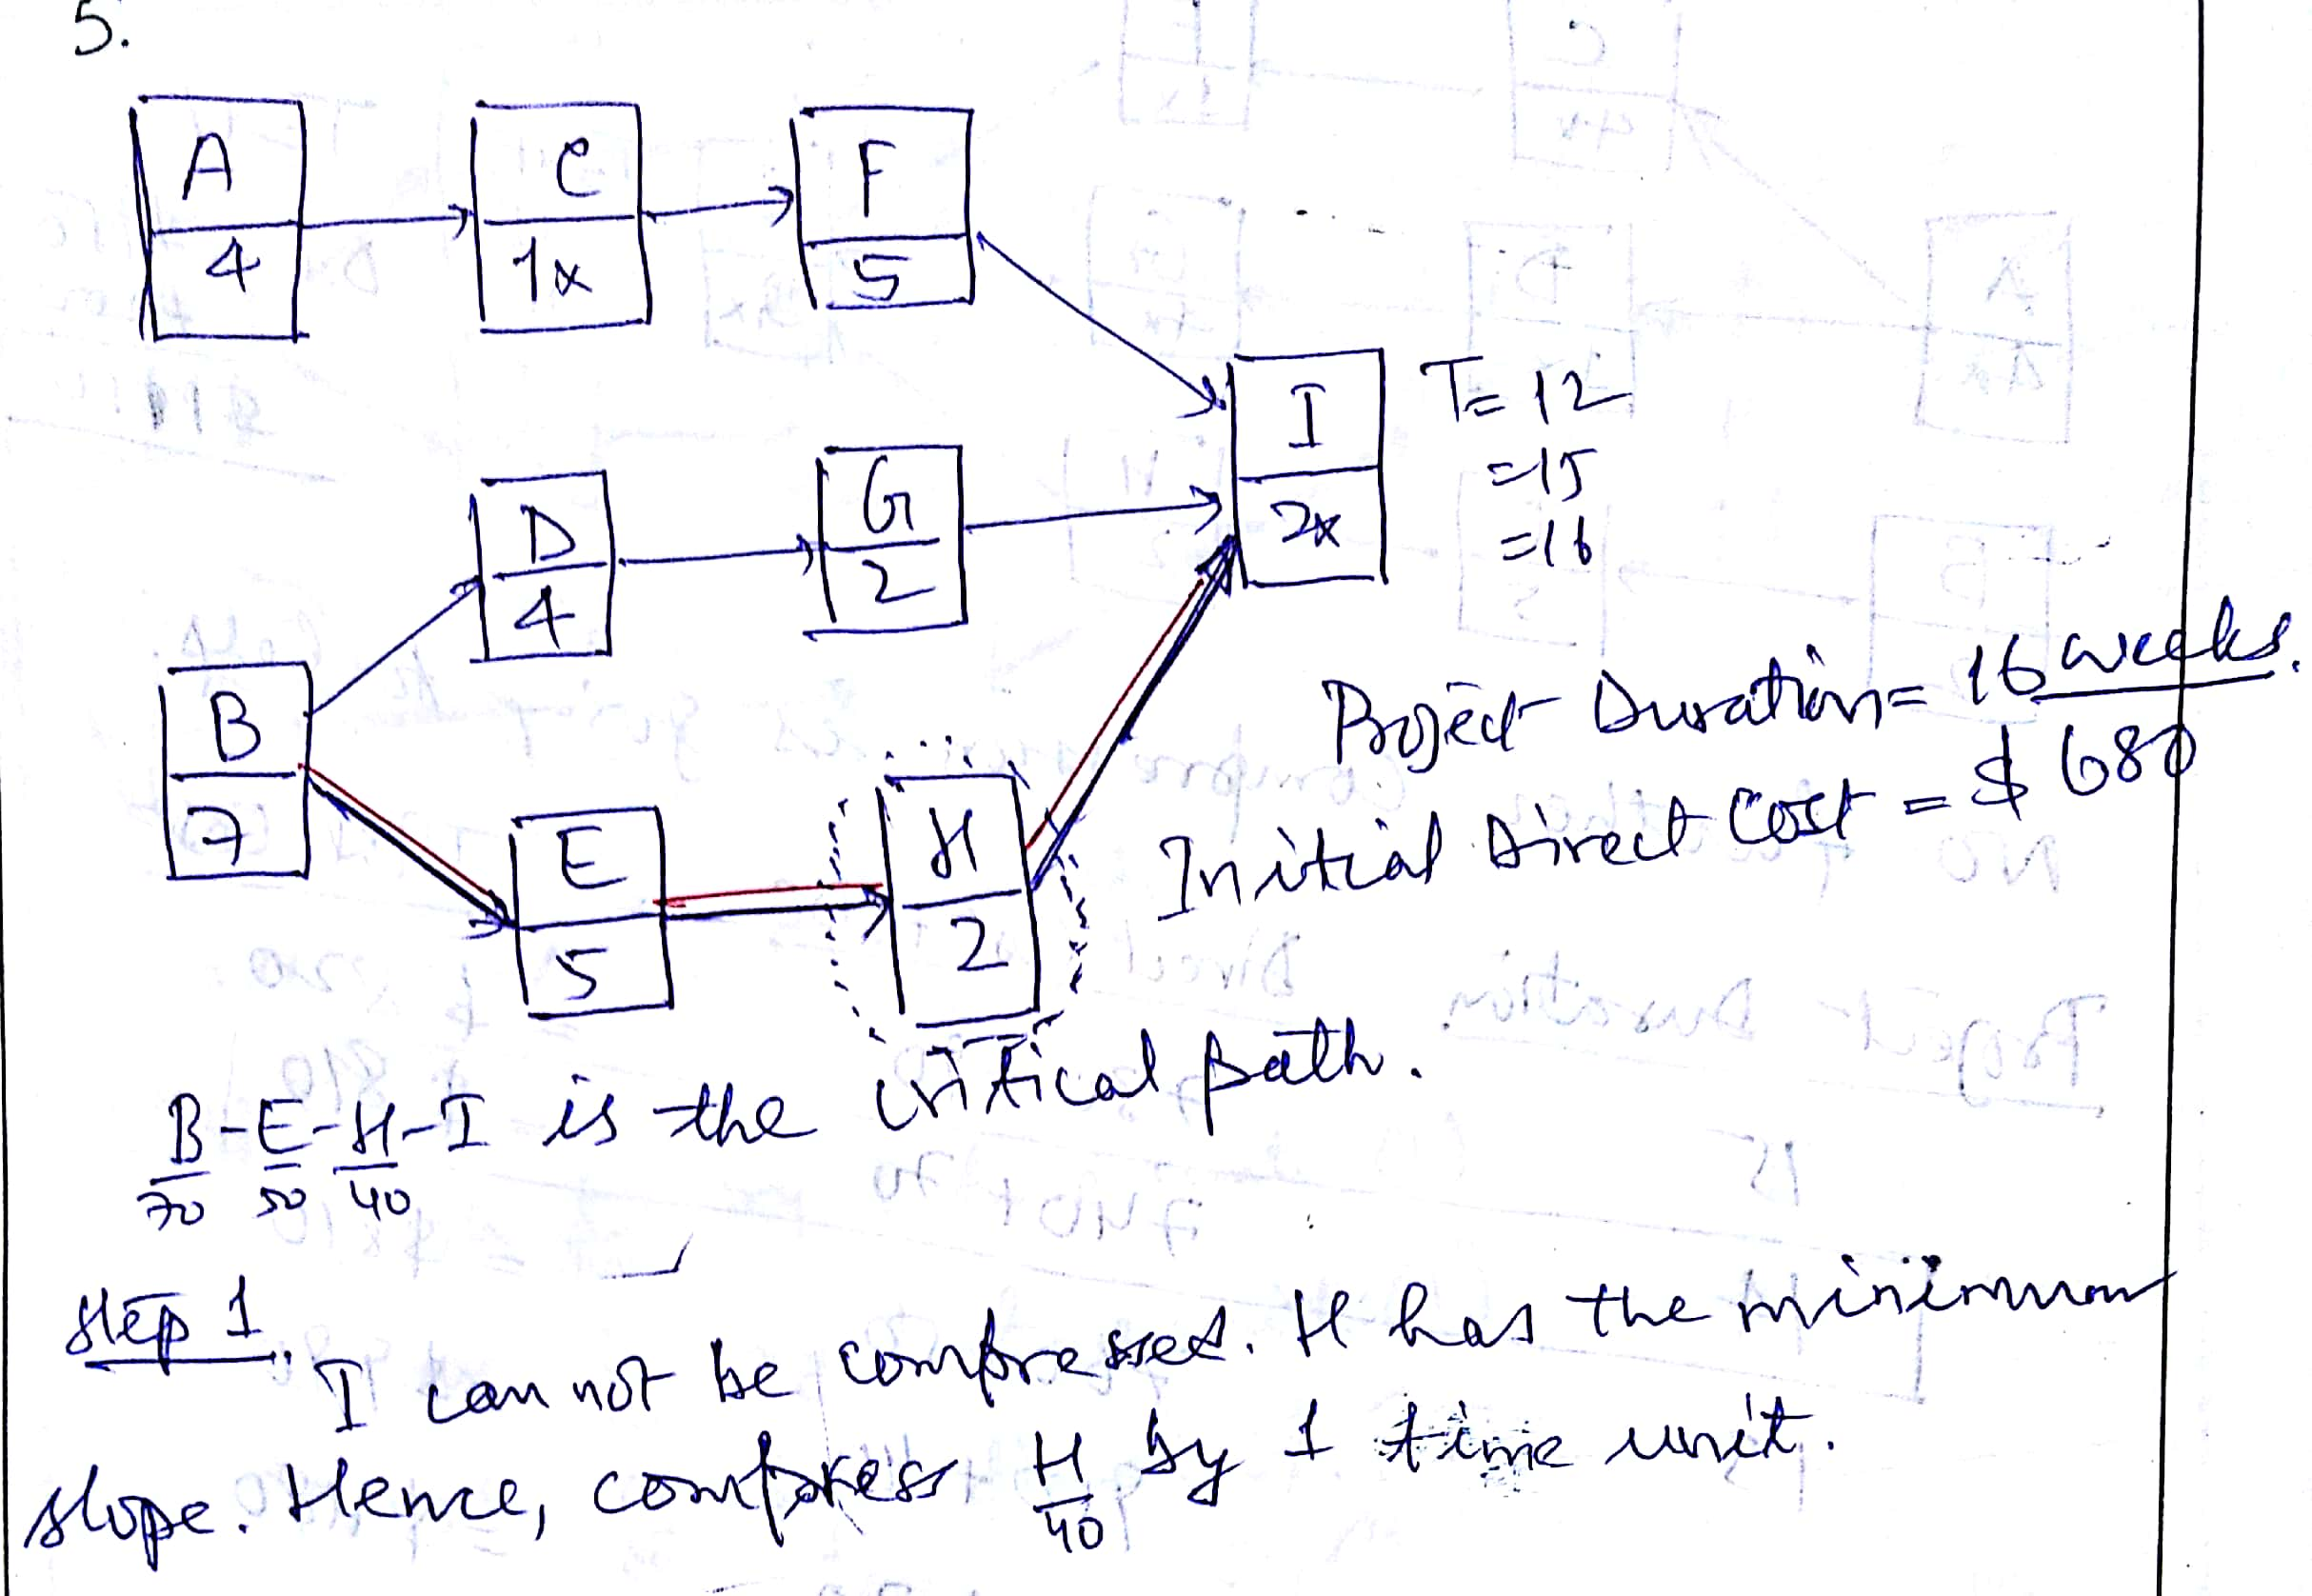
RPD

Slide 42
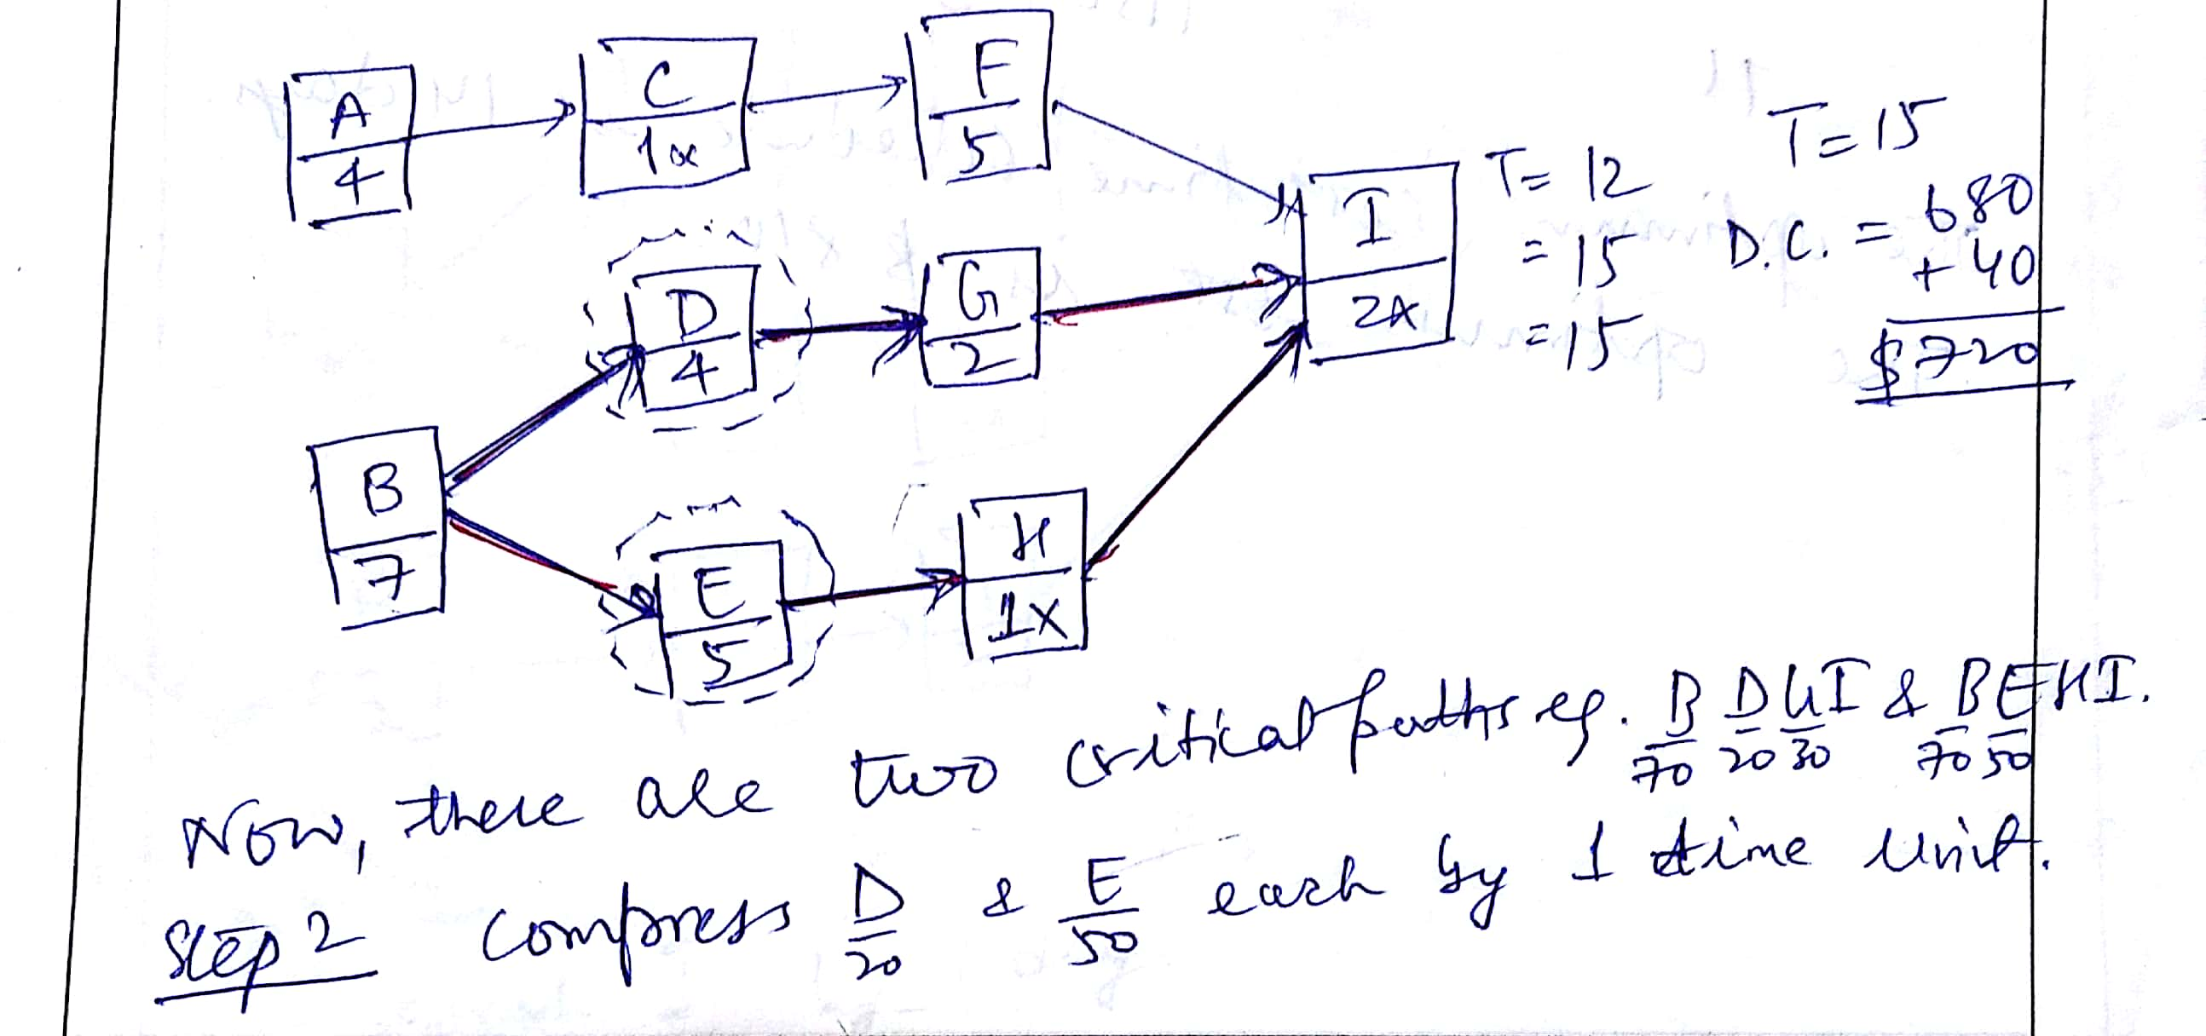

RPD

Slide 43
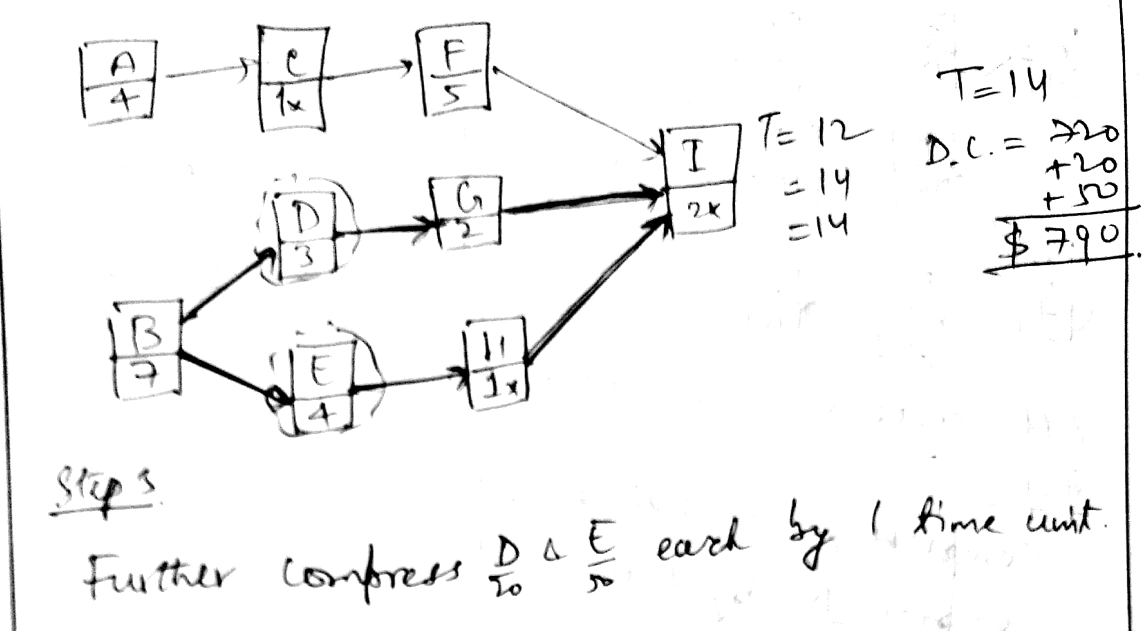
RPD

Slide 44
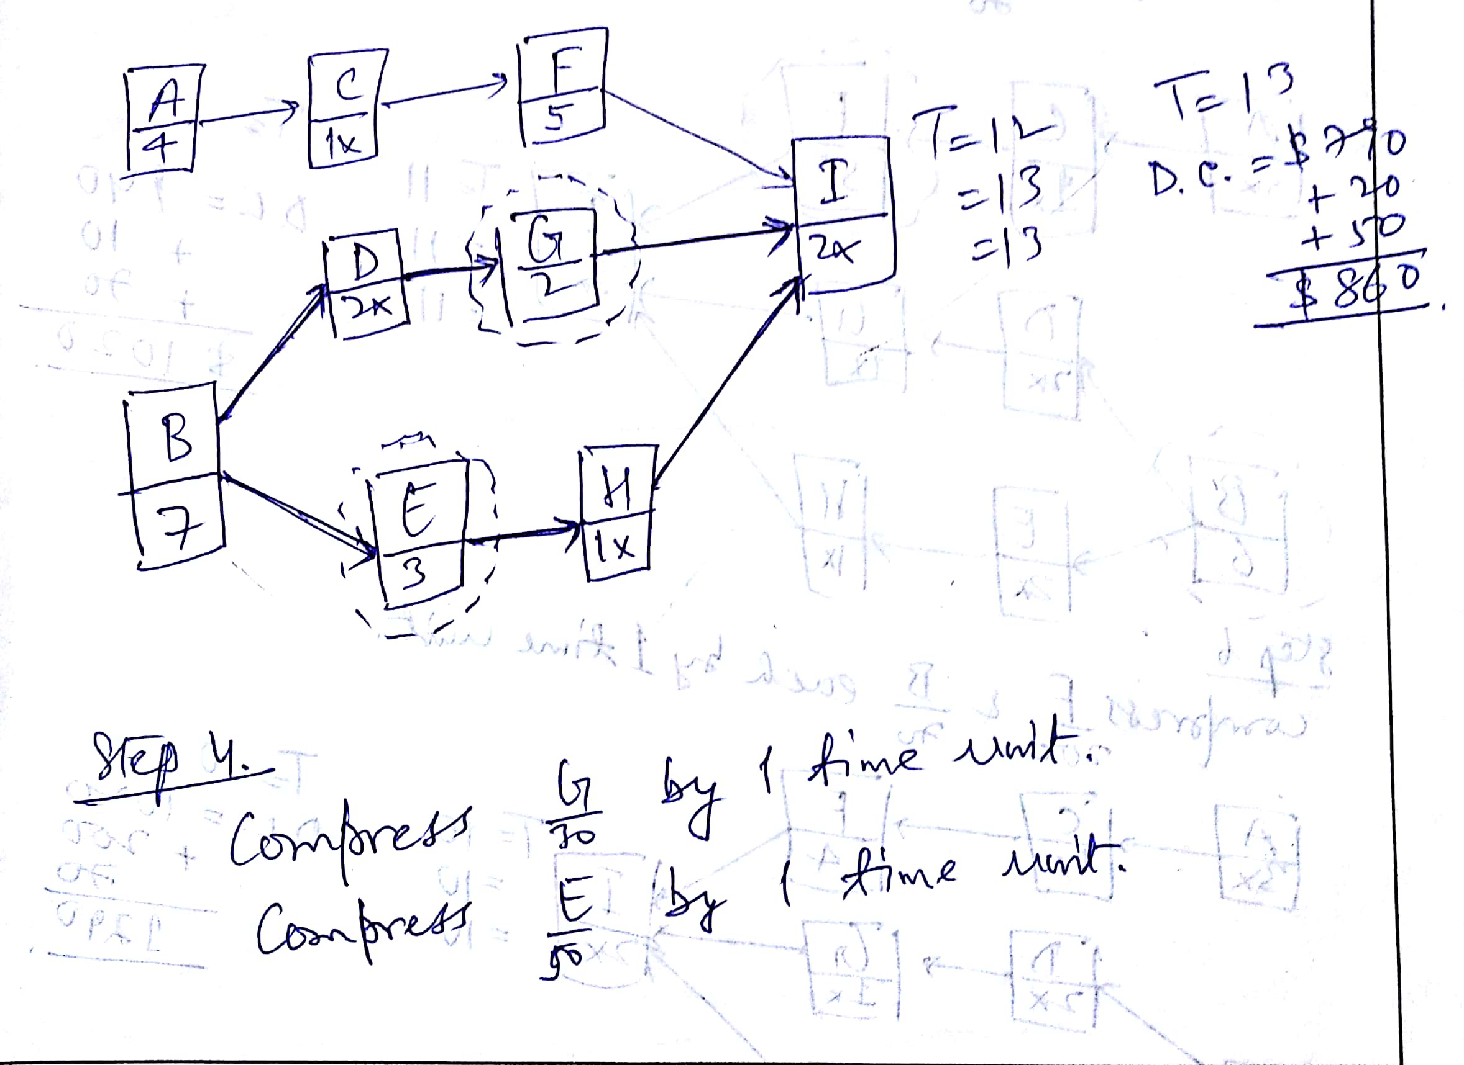
RPD

Slide 45
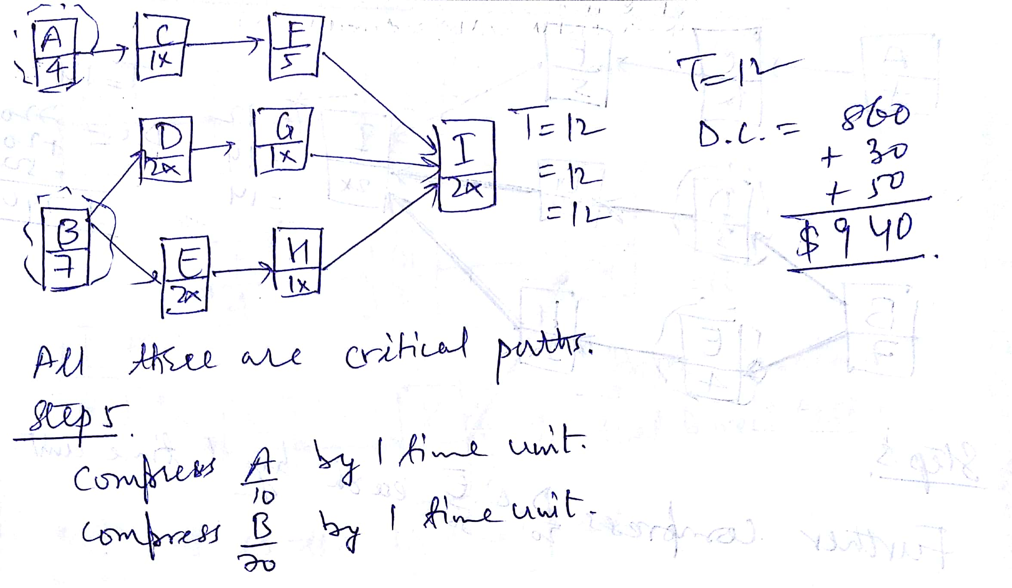
RPD

Slide 46
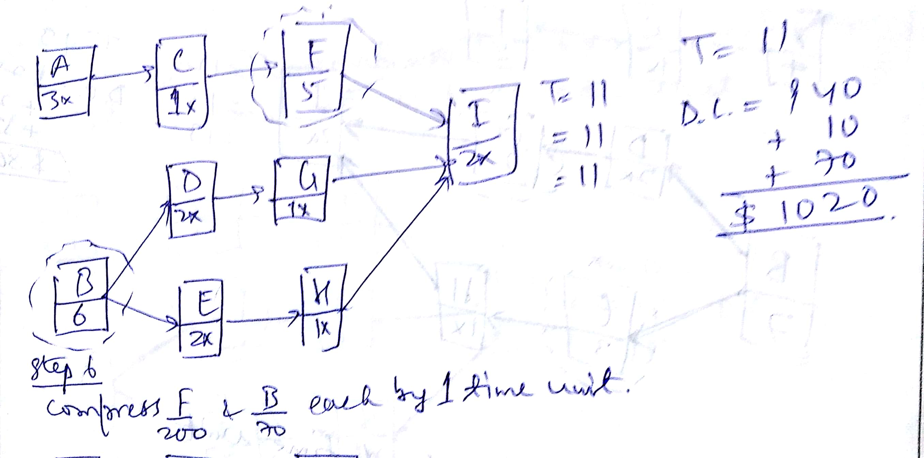
RPD

Slide 47
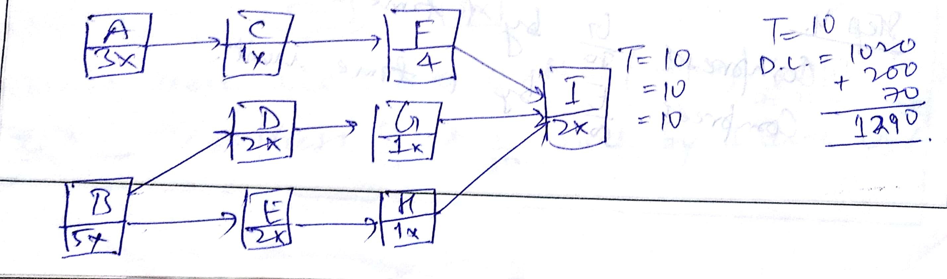
RPD

Slide 48

Exercise (Pages 496-497 - 5)
5. Answer
Duration Direct Cost Indirect Cost Total Cost
680 1200 1880
15 720 1130 1850
790 1000 1790
860 900 1760
12 940 860 1800
11 1020 820 1840
1290 790 2080
Optimum Cost-Time: $ 1760 / 13 Weeks

Slide 49
Project Management
Thank You!

